Slide 1
Accommodations
Learning Objectives:
Students can explain the relationship between accommodation and protection under IDEA, ADA and Section 504.
Students can demonstrate how to request an accommodation in employment or education settings.
Students can differentiate between a reasonable and unreasonable accommodation.

Slide 2
Accommodation:
Consider the following scenarios:
Suppose your employer wants to use a coworker of yours who knows a little bit of sign language to be assigned as your interpreter. Is this a reasonable accommodation?
Suppose you want your employer to hire only your favorite interpreter. Is this a reasonable accommodation?
Your employer asks that you read meeting notes instead of attending. Is this a reasonable accommodation?
A teammate schedules a meeting for a group project entirely in “chat” (instant messaging) with no audio. If this reasonable?
Kick-off Activity

Slide 3
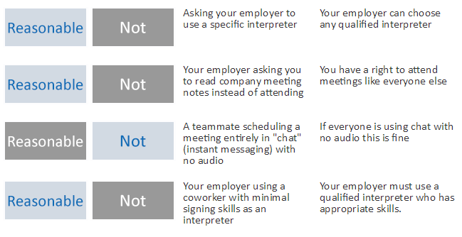
Accommodation:
Classroom Activity

Slide 4
Map It Online Activity:
Discussion Questions:
Describe how your rights under IDEA are different then under the ADA.
What does reasonable mean? What is an example of a reasonable accommodation?
What does it mean to be a self-advocate and how does it relate to accommodations?
What accommodations have you used in school and at work?
Laws and Accommodation

Slide 5
Map It Online Activity:
Discussion Questions:
Explain the importance of accommodations in employment and education settings.
Share examples of different types of reasonable accommodations.
Does accommodation differ between employment and education settings?
Have students make a chart of different reasonable accommodations and graph student usage.
Create a research project where small groups find interesting facts on different accommodations and investigate online resources to learn more about ADA.
Examples of Accommodations

Slide 6
Accommodation:
Create a list of individuals to interview who would be willing to share their personal experience related to accommodations in the workplace and/or higher education. The list may include teachers, family members, friends, coworkers, or supervisors.
Ask the following questions:
Share a time who you needed to self-advocate for your accommodations.
How has ADA helped you receive equal access at work, in the community, or at a higher education institution?
What advice can you offer about requesting accommodations?
Interview Activity

Slide 7
Synthesis Activity:
Complete the Accommodation Identification handout to identify accommodations in an employment or education setting. Review previous materials from Section 1 and 2 to support the first three steps:
Start by writing a description that includes a sentence about identity.
Add 1-2 sentences regarding disability and associated impact.
Make a list of accommodations received under IDEA while in high school.
Decide if those accommodations might be different in your future career or college/training program.
Consider if the accommodation is reasonable or not, and write down any alternative option you can think of.
Accommodation Identification

Slide 8
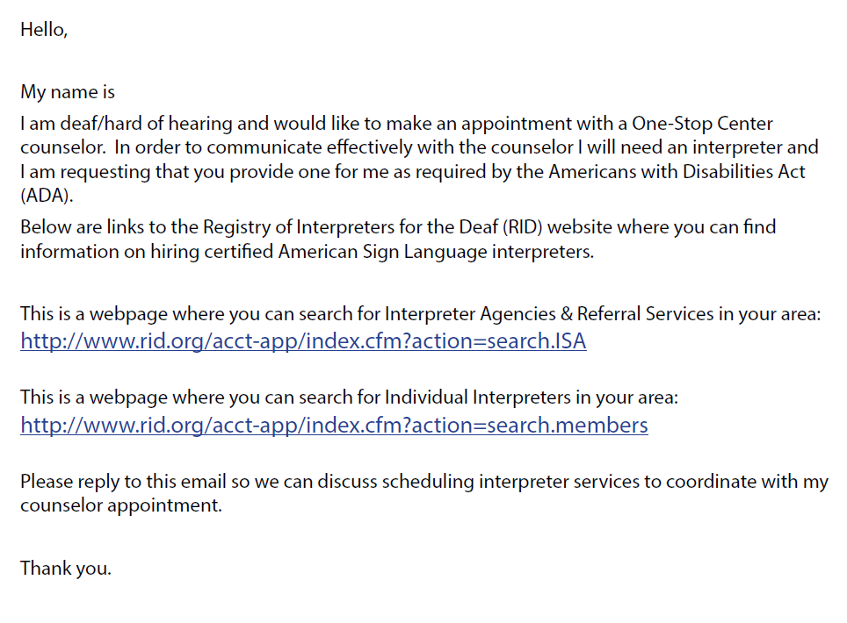
Accommodation:
Write a letter of request for a preferred accommodation to a One-Stop Career Center or Professor.
Letter of Request Activity

Slide 9
Accommodation:
Exit Ticket
Answer the following questions:
In kindergarten through high school graduation, you will receive accommodations under which law? ADA, IDEA, or Section 504 (circle the correct answer)
True or False In the workplace you have a right to accommodations under ADA.
Whose responsibility is it to make sure you receive the accommodations you need in higher education or employment settings?

