Slide 1
Being Deaf or
Hard of Hearing
Learning Objectives:
Students will recognize individual differences in hearing loss and communication.
Students will discuss their hearing loss, communication preferences and accommodations in the school setting.

Slide 2
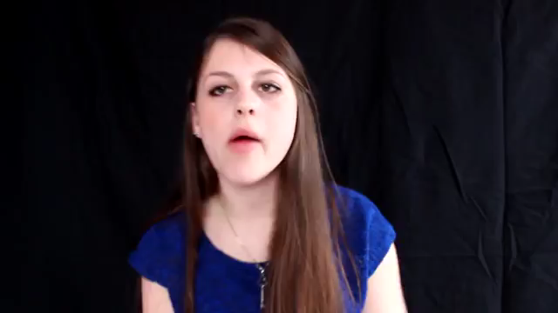
Kick-off Discussion:
Option 1- Confidence: Deaf in a hearing world

Slide 3
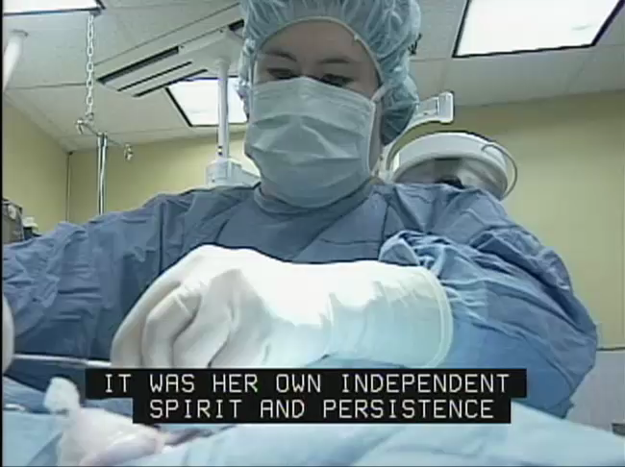
Kick-off Discussion:
Option 2- Kimberly Dodge
http://www.pepnet.org/resources/ag1

Slide 4
Key Term Review
Accommodations
Deaf or
Hard of Hearing
Tactile Sign Language
Do you recognize these terms? Can you define them?
Assistive Listening Device (ALD)
Notetaker
Total Communication
Closed Captioning
Interpreter
Video Relay Service (VRS)
Cued Speech
Speech-to-text
Video Remote Interpreting (VRI)
Speechreading
(lipreading)

Slide 5
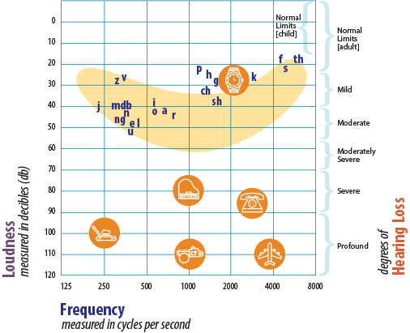
Identity Activity
Audiogram of Familiar Sounds
The speech sounds on this chart are approximations. The specific pitch of a human voice will vary depending on whether a man, woman or child is speaking. The distance between the speaker and listener will also impact speech sounds, creating a variety in sound intensity (loud or soft) for the listener.
Adapted from the American Academy of Audiology and Northern, J. & Downs, M., Hearing in Children, (5th Edition, pg. 18), Lippincott Williams and Wilkins, Baltimore, MD, 2002.

Slide 6
Key Term
Word Match
Directions: Write the letter of the correct match next to each key term.

Slide 7
Communication Activity
American Sign Language
Combined ASL and English
Cued Speech
Signed English
Speed and Lip-reading
Tactile Sign Language
Total Communication
?
Can you think of other communication methods?
Which do you prefer?
Do you have different preferences in different situations or settings?

Slide 8
Accommodation Activity
sign language interpreter
oral interpreter
cued speech interpreter
Speech-to-text (CART, Typewell, C-Print)
Notetaker
early registration for classes
extended test time
Video Relay Service (VRS)
Video Remote Interpreting (VRI)
?
Which accommodations do you currently use at school?
Are there other accommodations available in the community, post-secondary program or on the job?
Do accommodation preferences differ in settings?
Why is it important to try new accommodations?

Slide 9
Create your own “About My Hearing” Activity
^{I am Deaf.}
I use ASL in school and with friends. It’s hard to communicate with my parents because they don’t know ASL.
I have cochlear implants and speak. I don’t know any other deaf or hard of hearing people.
I use CART.
I use sign but I have to learn tactile sign because I am becoming blind. I use interpreters but I do have some hearing left.

