Slide 1
Career Awareness
Learning Objectives:
Students can articulate potential careers they would like to explore.
Students can relate information of self to different careers.

Slide 2
Career Awareness
Kick-off Activity:
Watch DPAN.TV Real People video series to build awareness of interesting careers for students, including opportunities for self-employment.
  Meet, Jennifer Ilene, a self-employed Exotic Animal Photographer (2:58), https://dpan.tv/series/realpeople/episode/jennifer-ilene.

Slide 3
Career Awareness
Classroom Activity:
Discussion Prompts:
  What are your thoughts about Jennifer’s job?
  Is this a career you’ve ever considered?
  What experiences influenced Jennifer’s journey to becoming an exotic animal photographer?
  What skills does it take to work with animals in this way?
  What is Jennifer’s advice for you?

Slide 4
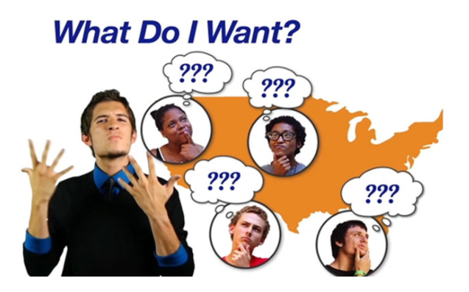

Map It Online Activity:
In Section 1, you learned about yourself and identified some dreams.
In Section 2, you will learn how to:
Find careers that fit you
Write goals that lead to success.
What Do I Want & Getting Started

Slide 5

Map It Online Activity:
Steps for career goals:
1. Know Yourself: Identify your values, interests, and skills
2. Explore Your Options: Think about what choices you have, find out about the job of interest.
3. Find out more about the job by asking others in that field.
4. Get experience by volunteering, working part-time, or job shadowing.
As a whole class, revisit the Your Goals slide to further explore the options and opportunities associated with part time jobs and volunteer opportunities.
Career Goals

Slide 6
Career Interest Inventory Activity
Complete the following online Interest Inventory, O*NET My Next Move, developed by the U.S. Department of Labor for students, https://www.mynextmove.org/explore/ip.
Learn more about each job and required education/training.
See your ‘best’ fit.
Print and save in your Career Portfolio.

Slide 7
Job Shadowing with Career Central
Based on what you learned about yourself in Who Am I section and your career list from O*NET My Next Move Interest Inventory, choose careers that match your interest for online job shadowing.
Pepnet2 Career Central: http://lms.pepnet.org/career_central.php.
Search careers by career interests, career cluster, education, industry, ‘green’ jobs, or work importance profile.
Watching the Job Shadow Video and review the Job Description for each career interest.
Rate your interest of each job in Career Central’s Career Journal (log in first to save journal entries).

Slide 8
Career Awareness and Personality
Review your Personality Assessment:
  What did you learn about your personality in section 1?
  Do you think your results accurately represent you?
Review the list of jobs from Career Interest Inventory to see if the job characteristic and your personality make a good match.
Participate in a whole class discussion:
  Was there a match between your personality traits and ‘dream’ job?
  How was this process for you? Do you agree or disagree with what you learned?
  Which of your personality traits do you think will be most important to your future career?

Slide 9
Career Awareness and Multiple Intelligences
Review of the eight different Multiple Intelligence categories http://australiancurriculumf-6resources.blogspot.com/2013/04/gardner-multiple-intelligences.html
Watch the following video: Howard Gardner’s Theory of Multiple Intelligence, https://youtu.be/1wkFGXqJxas.
Review the Multiple Intelligences Career Chart handout and circle the possible careers you are interested in based on your intelligence categories.
Researching famous examples of individuals and associated possible careers.
Share your findings!

Slide 10
Career Awareness and Values
For this activity, you will need to access the following O*NET Resource Center tools:
Work Importance Locator Instrument: https://www.onetcenter.org/dl_tools/WIL_zips/WIL-Instr-deskv.pdf
Work Values Cards: https://www.onetcenter.org/dl_tools/WIL_zips/WIL-Cards-deskv.pdf
Work Value Card Sorting Sheet: https://www.onetcenter.org/dl_tools/WIL_zips/WIL-Sheet-deskv.pdf
Work Importance Locator Score Report: https://www.onetcenter.org/dl_tools/WIL_zips/WIL-SR-deskp.pdf

Slide 11
Career Awareness and Values
Personal Values: 1. Adventure/Fun, 2. Friendship/Family, 3. Money/Wealth, 4. Justice/Honesty, 5. Spirituality/Religion, and 6. Knowledge/Education
Work Values: 1. Achievement, 2. Relationships, 3. Independence, 4. Support, 5. Recognition, and 6. Work Conditions.

Slide 12
Career Awareness Exit Slip
Make a list of 6-12 careers you would like to further explore.
Of those listed, circle the careers that best match your personality, interests, and values.

