Slide 1
Career Exploration
Learning Objectives:
Students can give at least two examples of how individual skills and interests relate to a variety of career pathways.
Students understand what training and education is required to find success in a variety of careers.

Slide 2
Career Exploration
Kick-off Activity:
Reality Check video from CAREERwide Education: https://vimeo.com/iseek/realitycheck.
Meet Dave, a 22 year old, about to graduate college. His ‘big’ dreams consist of making $150k a year, own a big house and multiple nice cars, and take lots of vacations with friends.
After watching the video, answer the following questions:
  What were Dave’s big dreams upon graduating from college?
  How much did Dave think he would make as a Software Developer?
  Why aren’t Dave’s plans very realistic?
  How does that impact his big dreams?

Slide 3
Career Exploration Classroom Activity:
Use an online Reality Check tool , Jump$tart: http://www.jumpstart.org/reality-check.html
Imagine you just graduated from high school and are about to embark on the adventure of adulthood.
As a group, answer the following Reality Check tool questions for your own “Dave” character.
  Decide answer to each question and click on answer.
  How much salary will your character need to meet their lifestyle choice?
  What are some jobs that can support such a lifestyle?
  What education level provides that hourly wage?
  Is your character’s lifestyle dreams realistic?

Slide 4

Map It Online Activity:
Explore different types of education or training.
Explore the relationship between how much education or training you have and how much money you earn.
Education Goals

Slide 5
Career Exploration :
Practice your research skills associated with career exploration.
Choose a career from your interest list.
Gather information from job descriptions, Career Central, O*NET, and other websites to learn more about job duties, responsibilities, required education/training, minimum experience, earnings, and advancement opportunities.
Consider geographic locations, benefits, and other information related to the Labor Market.
Use the Big 6 Getting Started or Research Project Organizer handouts to organize your project
Choose the best mode of representation and expression for capturing and sharing research information. Suggestions include: PowerPoint or Prezi presentation, short video, story board, multi-media format, or lecture.
Career Research Activity

Slide 6
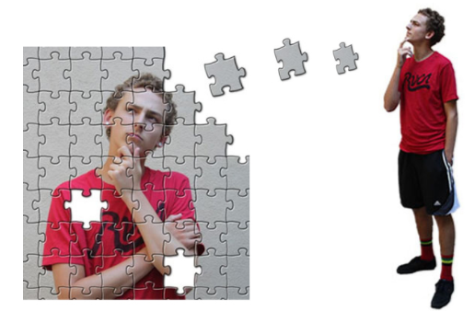
Map It Online Activity:
How can you use what you know about your identity and personality to make a good job match?
Next Steps

Slide 7

Map It Online Activity:
Career Clusters are groups of jobs that require similar knowledge and skills. Ready, set, explore!
Career Clusters

Slide 8
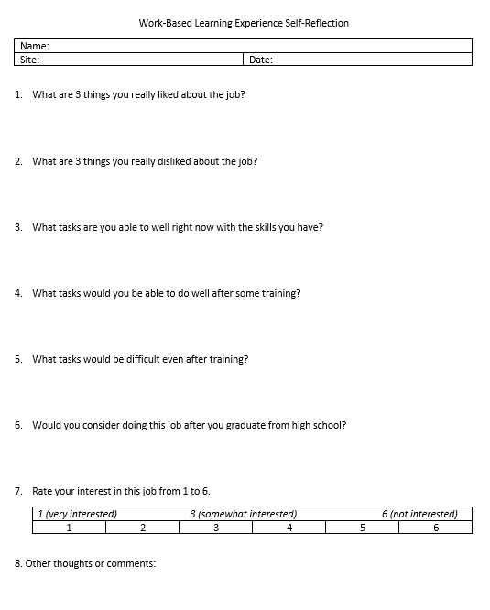
Career Exploration:
Community Based Job Shadows

Slide 9
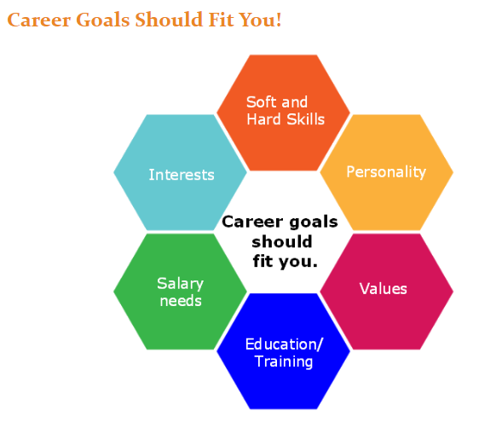
Map It Online Activity:
Career Goals

Slide 10
Career Exploration:
Create a list of local occupations to invite to an Occupation Interview.
Ask the employer to share what their business is about and discuss career goals related to their occupation.
Prepare by researching the company beforehand to build background knowledge and develop meaningful questions.
Questions may include:
  How did you get this job?
  What kind of training/certification is needed?
  Describe your typical work day.
  What 3 hard skills do you use most often? 3 soft skills?
  What are entry level jobs in your field?
  What are examples of career goals related to your field?
  Here are my strengths. How do they fit in this field?
Follow up with a thank you note for each interviewee.
Occupation Interview

Slide 11
Career Exploration:
Watch Biz Kid$ It’s A Job Getting a Job on DCMP: https://www.dcmp.org/media/7094-biz-kid-it-s-a-job-getting-a-job/stream?digest=34716 (watch the first 4:20 seconds for this activity)
Meet Ray, the owner of Fabulous, a motor coach company. Students are introduced to Ray (owner), Larry (driver), and Hilary (Human Resource Representative). Discuss these various job within a single company (occupation).
What are the roles and responsibilities of each person?
What are the skills needed for each job?
What does Hilary look for in a potential employee?
What advice does Ray offer?
Which role would be best for you based on your Learning Style Inventory and Multiple Intelligence Assessment from Section One?
It’s a Job Getting a Job Activity

Slide 12
Career Exploration:
Independently complete a Jump$tart online reality Check: http://www.jumpstart.org/reality-check.html (or use your state’s CIS Reality Check program).
Answer the questions to the best of your abilities by clicking on the answer.
In pairs or small groups, discuss the following questions:
  Are your results what you expected?
  Do the jobs align with your job zone or career cluster?
  What level of education do you need to reach your needed salary?
  Are your lifestyle goals realistic?
Reality Check

Slide 13
Career Exploration:
Start your Career Portfolio for both employment and post-secondary education/training programs.
Gather material in a binder, or accordion file, or students upload materials to a free online ePortfolios, such as Pathbrite (https://pathbrite.com/#maker).
Portfolio materials may include the following items: achievements, best course work, special projects, and extracurricular activities.
Within a Career Portfolio, show what you know and who you are through a visual collection of meaningful material.
(Teacher’s Note: If using ePortfolio- choose resources that may help students get started):
  Ohio Department of Administrative Services: http://das.ohio.gov/Portals/0/DASDivisions/HumanResources/LPD/pdf/LPD_CareerPortfolio.pdf
  Oklahoma Department of Career and Technology: https://www.okcareertech.org/educators/career-and-academic-connections/11756CarActFile.pdf
  Heritage High School 21st Century Digital Portfolio: http://heritage.nn.k12.va.us/career_portfolios.html
  Maine Career Advantage: http://www2.sfasu.edu/cte/Michelle_Files/HMS_102_Web_Content/career_portfolio.pdf
Career Portfolio

Slide 14
Career Exploration:
Start your resume, a tool that summarizes your qualifications:
  Contact information
  Education
  Work/Volunteer experiences
  Skills
  Abilities
Resumes are included in your Career Portfolio and required by most Human Resources departments for applicants.
Access resume builder programs through your state’s Career Information Systems (CIS), templates in computer software, and a variety of other online programs.
Save 3 file types of your resume by graduation: original (word doc or other compatible format), a pdf, and plain text (for online submission).
Resume

Slide 15
Career Exploration:
A Visual Resume is similar to a traditional resume, but offers employers a visual representation of who you are and what you can do.
  Access the Visual Resume Template and Allison’s Visual Resume Example handouts to help create a visual resume.
Highlight your individual skills and connect your interest to the career field.
Include your interests/passion, previous volunteer, work, or intern experience, and soft and hard skills.
Keep your Visual Resume short, specific, and show the job seeker images of you actively performing job tasks.
At the end, you may choose to include personal references, work samples, and links to relevant online portfolios.
Helpful guidelines for creating a visual resume:
  Profile picture should be of student and look professional (not with family members, pets, etc)
  Highlight positive hard and soft skills and relate to skills to the work setting.
  Share examples of high quality work or other helpful resources related to career field.
  Beside profile picture, all other pictures should relate to job tasks or show skills related to position.
Visual Resume

Slide 16
Career Exploration:
Pick one of the careers you chose to further explore and answer the following questions:
  Name of occupation
  List two skills and/or interests you have that support this occupation.
  What level of education or training is needed?
Exit Ticket

