Slide 1
Career Preparation
Learning Objectives:
Students can make a contribution in a work setting.
Students can build effective relationships in a work setting.

Slide 2
Career Preparation
Kick-off Activity:
Problem-Solution Team Building Game
Divide into 2 teams.
Use the enclosed problem-solution cards.
Each card contains a problem (P) related to work-readiness skills.
Each problem has a solution (S), as well as an innovative solution (IS).
After you receive the problem, work with your team (1-2 min) to determine the best solution and write it on a dry erase board.
Receive 1 point if your solution matches the one on the card.
Receive 2 points if your solution qualifies as an innovative solution.
First group to reach 20 wins!

Slide 3
Career Preparation Classroom Activity:
Classroom discussion:
What strengths and traits did each of you bring to the activity?
What other abilities did you notice from your peers?
How did you work together to identify innovative solutions?
How do the solutions transfer to having strong work ethics?
How are work ethics influenced by our values?

Slide 4
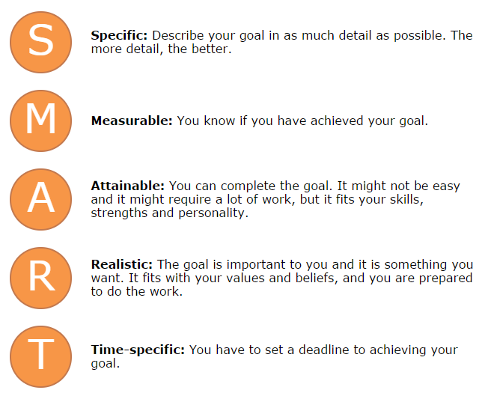
Map It Online Activity:
SMART Goals

Slide 5
Career Preparation :
Watch Biz Kid$: Taking Charge of Your Financial Future (27:57), https://dcmp.org/media/7045-biz-kid-taking-charge-of-your-financial-future/stream?digest=34566
During the video, Biz Kids explore SMART financial goals. Watch a Biz Kid sign up for a savings account at a bank and meet kid entrepreneurs.
As a class, come up with examples of SMART financial goals (Specific, Measureable, Achievable, Realistic, and Timely).
Next, set your own SMART financial goal(s).
Name some responsibilities around checking accounts and credit cards.
Practice balancing a checkbook or paying bills online.
Biz Kid$ SMART Goal Financial Literacy Activity

Slide 6
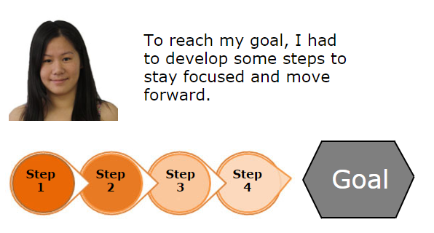
Map It Online Activity:
Goal Setting
What will you do first?
What can you do right now (short term)?
What can you do in the future (long term)?
What could stop you from achieving this goal (roadblock)?

Slide 7
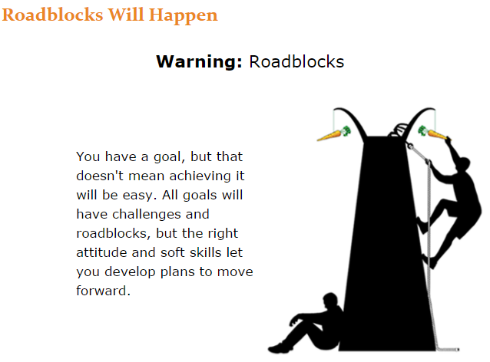
Map It Online Activity:
Identify the roadblock.
Evaluate my options.
Develop a plan.

Slide 8
Career Preparation :
Learn how to use the following job search tools:
One-Stop Career Center: careeronestop.org
O*NET Online: onetonline.org
State Career Information System
Local Job Service Center
Local newspaper classified section (hardcopy and/or online)
Local college or university Human Resource Department (explore work study and other employment opportunities for those students college bound)
Search your top three career interests, and see what’s available in your community or in a location you hope to live in the future. Answer the following questions:
What are the application requirements?
What is the required education/training?
What is the required related work experience/skills needed?
What skills will you need to develop to get the job?
What is a good way to learn those skills?
How to Search for Job Activity

Slide 9
Career Preparation :
Take 2-3 minutes to highlight each error you notice on the application.
When finished, count the numbers of errors you found and write the number on the front side of the application.
Those closest to the actual number wins!
Review How to Fill Out an Application handout. Use a fresh copy of the application, and practice filling in as much information as possible (continue working on the application at home to find any missing information).
Whole Class discussion:
If you were hiring for this position, would you hire this person?
What strengths did you choose to include?
What character traits did you choose to include?
What is something new you learned through this activity?
Completing an Application

Slide 10
Career Preparation :
Watch the following DCMP video, Getting It Right At the Interview, https://www.dcmp.org/media/6343-getting-it-right-at-the-interview-student-version/stream?digest=31737 (24:23).
Take notes on the basics of a job interview including: preparation, skills-based resume, cover letter, first impression, communication skills, appropriate body language, potential interview questions, benefits of mock interviews, and the importance of understanding one’s career goals.
Whole class discussion:
What are the steps for making a good first impression?
What are three examples on how to make a good first impression?
What does it mean to “sell” yourself?
What is a skill-based resume?
What are some topics for “small” talk?
What are questions that may be asked at an interview?
Extension Activities:
Behavioral Questioning Role Play
First Impression Attire Activity
It’s a Job Getting a Job Activity

Slide 11
Career Preparation :
Complete the following steps:
1. Gather community resource information.
2. Organize information in a table (see sample Community Resource Mapping handout, from the National Center on Secondary Education and Transition)
3. Mark/label facilities and resources on a community map.
Whole Class Discussion:
Name some places new to you.
What places interest you for work?
What service agencies can help connect you to employment?
What places can help connect you to community participation?
Where can you attend post-secondary education/training programs to meet career goals?
Community Resource Mapping

Slide 12
Career Preparation :
Practice being the interviewer with a professional in a field of interest (consider professionals at school, parents, local business owners, or current supervisor in volunteer, internship, or work setting).
Ask permission to take video of the interview, so you can further analyze later.
Start the interview by offering casual conversation with the professional.
Ask the following questions and add one or two of your own:
  Why did you want to work here?
  What skills and strengths do you bring to the company?
  How does your personality fit the culture of the company?
  Where do you see yourself in five years?
After the interview is complete, review the video and reflect on the following questions:
What soft skills did you notice throughout the interview?
How did the professional answer questions about their strengths?
What did you learn about their work culture?
What does their five year vision say about their career goals?
Professional Interview

Slide 13
Career Preparation :
Students should reflect on one of their work-based learning experiences (an internship, volunteer, temp job, or other paid/unpaid work) and list:
  Two contributions they made to the job site.
  Two ways they built healthy relationships with supervisors and/or co-workers.
Exit Ticket

