Slide 1
Disclosure
Learning Objectives:
Students can think critically about disability disclosure in a variety of settings.
Students can demonstrate disclosure of their disability.

Slide 2
Disclosure:
Watch the video of Norman Kunc, The Right to be Disabled, as he discusses a pivotal moment when he realized he had "the right to be disabled," and his life changed. He recounts why this was a pivotal moment in his life and the unexpected insights that arose out of this new perspective, https://youtu.be/QM6epVgyPFo (11:27).
Kick-off Activity

Slide 3
Disclosure: Classroom Activity
Discuss the following questions in small groups and then as a whole class discuss differing perspectives.
How does Norm’s story relate to access and equal opportunity for all people?
What are your thoughts on Norm’s statement of “architectural correction” versus “accommodation”?
Give an example of an “architectural correction” you may need in a college or training program.
Give an example of an “architectural correction” you may need in an employment setting.
Any thoughts on your own “pivotal moment” in viewing disability?
Review sections of the video as needed to support full student understanding.

Slide 4
Map It Online Activity:
Use the first two Map It slides for Disclosure: Definition and Feedback About Your Accommodations.
Discussion questions:
What is disclosure?
What are the benefits of disclosing?
Why is it important to self-advocate when disclosing your disability?
Disclosure Definition and Feedback About Your Accommodations

Slide 5
Map It Online Activity:
Use the Map It slides Disclosure: Practice Your Disclosure Skills and Your Turn.
Practicing the steps of disclosure by referring to your Map It: Your Communication & Accommodations on the Your Turn slide.
Consider accommodations you have used in the past.
Imagine accommodations for your future (if needed, refer to your Accommodation Identification handout from the previous lesson)
With a peer, take turns practicing disability disclosure in a chosen employment or education setting.
Practice telling your partner about your hearing loss and how it impacts your access to information.
Speak on accommodations you currently use and what works best.
Next touch upon an accommodation you have used in the past that didn’t work, and offer an explanation of why.
Speak of accommodations you foresee using in future employment or education settings.
Make mention of any accommodation new to you that you would like to try.
Now practice disclosing your disability to a member of your IEP team.
Practice Your Disclosure Skills

Slide 6
Map It Online Activity:
Use the Map It slides Disclosure: Steven’s Disclosure and Brooke’s Disclosure slides. Divide into appropriate groups, and discuss the following questions:
Job path discussion prompts:
What challenges did Steven face in his science lab job?
How did disability disclosure help Steven?
What roadblock did Brooke hit at her Taco House job?
Do you think Brooke’s experience would have been different if she had accommodations sooner? Why or why not?
College or training path discussion prompts:
What was unexpected for Steven as he started his new science program?
How did Steven problem solve roadblocks?
What has been challenging for Brooke since she entered beautician school?
What helped Brooke self-advocate for her required accommodation?
Steven and Brooke’s Disclosure

Slide 7
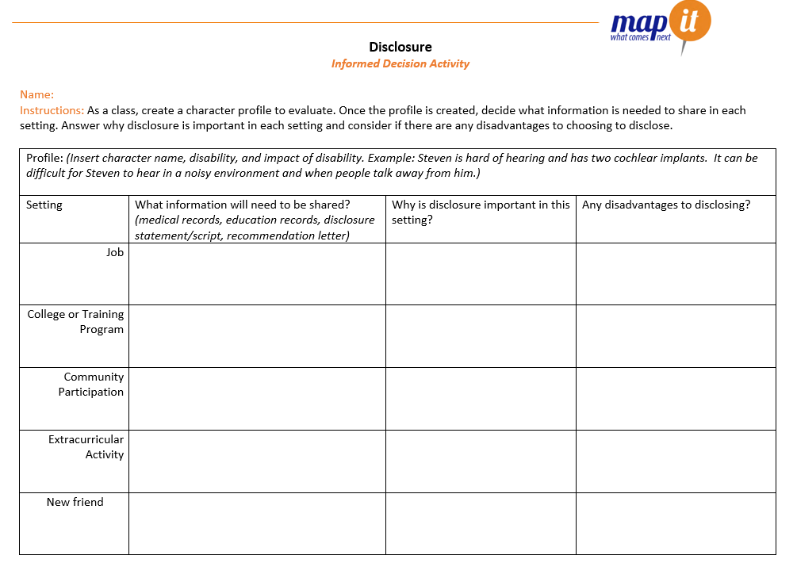
Synthesis Activity:
Together create a profile of a character to analyze.
Divide into small groups and analyze what disclosure looks like in a variety of settings, why it is important and consider any disadvantages.
Compare and contrast answers across groups.
Informed Decision Activity

Slide 8
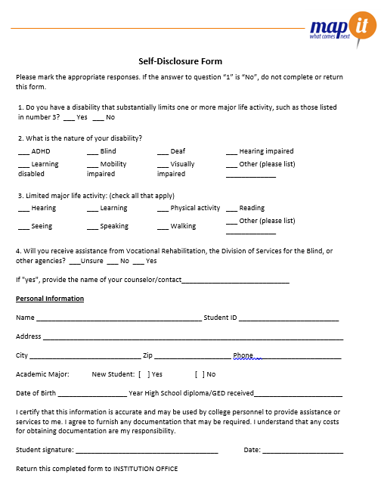
Disclosure:
Complete the Disclosure Packet handout which includes a form on Self-Disclosure, Release of Information, and Accommodation Request.
These forms are directed towards DSS, so talk with your teacher about modifying to meet employment goals.
Practice inserting required information on each form.
Gather supplemental eligibility materials you will need and add to your Career Portfolio for quick, easy access after graduation.
Be prepared to turn in completed forms with your Exit Slip.
Practicing Disclosure Packet Activity

Slide 9
Disclosure:
Exit Ticket
Disclose your disability in your preferred mode of communication.
Turn in your Disclosure Packet (Self-Disclosure, Release of Information, and Accommodation Request forms) to be graded on accuracy and thoroughness in completion.

