Slide 1
Dreams
Learning Objectives:
Students will identify a personal dream in the areas of education and training, employment, relationships, and independent living.
Students will analyze their dreams and determine which of their dreams should become personal goals.

Slide 2
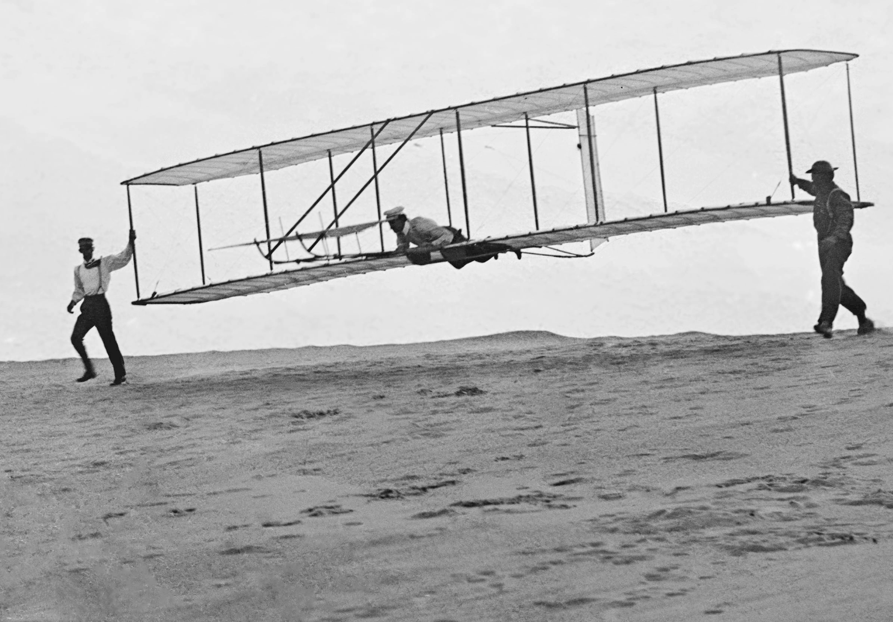
Kick-off Activity:
Choose one of the following videos about the Wright brothers:
  Aerial America: The Home of the Wright Brothers, http://www.smithsonianchannel.com/videos/the-home-of-the-wright-brothers/20903 (3:30)
  Stories- the Wright Brothers, Orville and Wilbur https://youtu.be/fZyZxDWjkZ0 (7:15).
  DCMP Inventing Flight for Schools: History of Flight Videos https://www.dcmp.org/media/5766-inventing-flight-for-schools-history-of-flight-videos/stream?digest=32052# (first 20:00)
Video Discussion Prompts:
What dream did Orville and Wilbur have?
What was their dream fueled by?
Who helped them along the way? How?
What experiences influenced the brothers along the way?
What obstacles did the brothers face?
How did the brother’s dream match their traits, strengths, interests, and skills?
The Wright brothers

Slide 3

Dreams Classroom Discussion Activity:
Share a time when you had to work hard for something you really wanted.
  Did you succeed?
  What obstacles did you face?
  What/who helped you along the way?
What makes some dreams realistic and other dreams unrealistic ?
  You need specific skills and abilities to make some dreams realistic.
  You need to be able to work hard, have commitment for some dreams.
  Some dreams are unrealistic because they are out of your control.
Throughout this lesson, you will be creating dreams in 3 areas of your life: education/training, employment, life (relationships and independent living).
You will have the chance to test these dreams to see if they are realistic and if they should become goals.

Slide 4




Map It Online Activity:
3 Categories of Dreams:
Education and Training
Employment
Life (relationships and living independently)
Dreams

Slide 5
Map It Online Activity:
Test It:
What are the four steps for analyzing your dreams?
Why is it important to evaluate your dreams to see if it fits your traits, strengths, skills, values and personality?
Why do you need to evaluate how much work the dream will take to become a goal?
Why is the last step important?
Goal Testing Discussion

Slide 6
Map It Online Activity:
Testing Goals with Marissa and Brandon:
How did the two Map It characters follow the four-step process in goal testing?
Why do you think Marissa did not want her dream of owning a huge house to become a goal?
Why do you think Brandon chose to make a goal about getting a Corvette?
If Marissa still dreams of her own place to live, how can she change her dream to be more realistic and a better fit?
Goal Testing Discussion

Slide 7


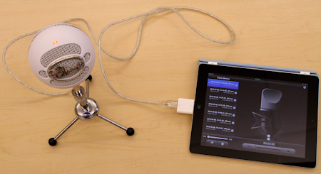
Dreams Art Cross Curriculum Activity:
After you’ve tested out your dreams, decide which one (or two) you would like to focus on by creating a collage, video, poem, or song:
Collage: use drawings, pictures in magazines, multimedia, or images copied from the Internet.
Video: record yourself or images that represent your dream, add music, type, etc.
Poem: consider haiku, couplet, free verse with collage, or shape poetry can take on the features of your dream.
Song/Rap: create some lyrics and put to your style of background or theme music.
Be creative!!

Slide 8
Dreams Art Cross Curriculum Activity:
Inspiration to help get started:
Song:
  Soon We’ll Be Found, by Sia: https://youtu.be/t1x8DMfbYN4?list=PLx1wHz1f-8J_xKVdU7DGa5RWIwWzRWNVt
  Happy by CM7 Deaf Film Camp: https://youtu.be/H3KSKS3TTbc
Poetry:
  “Dreams” by Langston Hughes: https://youtu.be/-HSn3o0kv4k
Inspirational quotes:
  “Obstacles cannot crush me. Every obstacle yields to stern resolve. He who is fixed to a star does not change his mind. Obstacles cannot crush me.”, Leonardo da Vinci (Artist, Inventor, Scientist)

Slide 9
Dreams Science/
Engineering Cross Curriculum Activity:
Learn more about the science and engineering of Orville and Wilbur Wright by learning more of their story:
  CommonLit (The Wright Brothers: Air Pioneers), https://www.commonlit.org/texts/the-wright-brothers-air-pioneers .
  Ducksters (Wright Brothers), (http://www.ducksters.com/biography/wright_brothers.php).
Learn about concepts of flight (control, lift, and propulsion) with Inventing Flight for Schools series on DCMP, https://www.dcmp.org/media/5766-inventing-flight-for-schools-history-of-flight-videos
Explore Four Forces of Flight and Newton’s Laws: https://www.dcmp.org/media/5767-inventing-flight-for-schools-tutorials/stream?digest=32054

Slide 10
Closing Activity:
“Who am I?”
After evaluating your four dreams in Map It, check the goal box on the “Who Am I” Summary Worksheet for any dream you would like to become a goal.

