Slide 1
Personality
Learning Objectives:
Students will describe their personality.
Students will state how knowing about their personality can affect career choices.

Slide 2

Kick-off Discussion:
1. Where were you born?
2. How many people are in your family?
3. What was your favorite activity as a child?
4. What was one of your favorite childhood memories?
5. Who was your favorite teacher? Why?
6. What was your favorite subject?
7. How were you involved in the community?
8. What was your neighborhood like?
9. What was your first job? Did you like it?
10. Where did you go to get your degree/certification?
21 Questions for Your Teacher

Slide 3
Kick-off Discussion:
11. List two or three different places you’ve lived.
12. What is your favorite genre of music?
13. What is the hardest thing you’ve ever done?
14. What’s your favorite recreational activity?
15. If you could travel anywhere, where would you go? Why?
16. What is one thing on your “bucket list”?
17. What is one thing you would do to change the world?
18. What has been your least favorite job? Your favorite?
19. What will you be doing five years from now?
20. If you could have a superpower, what would it be? Why?
21. How would your best friend describe you?
21 Questions for Your Teacher

Slide 4

Classroom Discussion
Work in small groups to create a short narrative highlighting “who I am”.
What helped influenced my choice to become a teacher?
  Think about my traits, strengths, weaknesses, hard and soft skills, values, and interests.
Don’t worry, if you get stuck, ask me additional questions.
Determine how your group will present their narrative to the class.
Compare and contrast as you listen to other narratives and perspectives.

Slide 5

Key Term:
Personality
The mixture of how you think, behave, and feel that makes you different from other people.
Personality

Slide 6
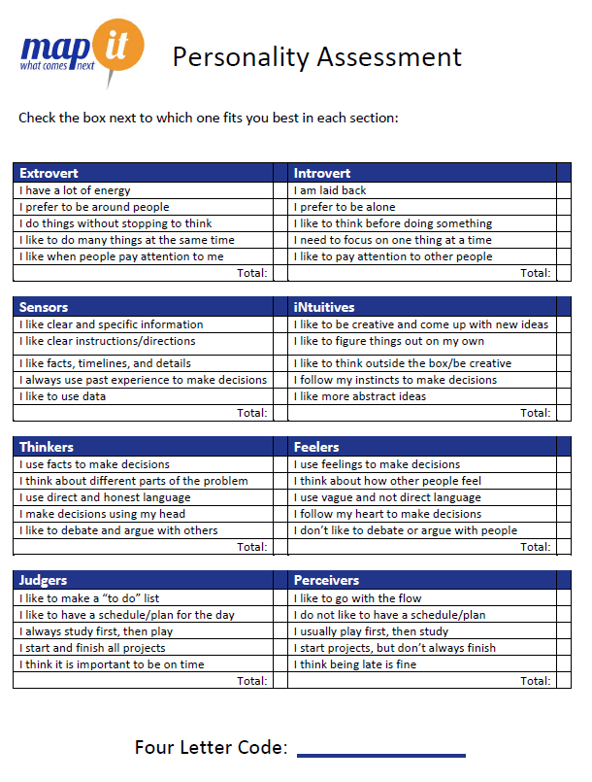
Map It Online Activity:
Personality Assessment

Slide 7
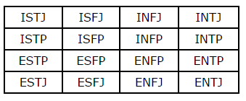
Map It Online Activity:
There are 8 letters that are used in the assessment, and they make up sixteen possible Myers-Briggs Types:
E – Extroversion indicates people who focus on the outer world of people and things. Indicates a tendency inwards towards your thoughts and ideas.
I – Introversion represents people who focus on the inner world of ideas and impressions.
S – Sensing defines people who process information through their five senses.
N – Intuition defines people who process information through patterns and possibilities.
T – Thinking people are objective and base their decisions on logic.
F – Feeling people are subjective and tend to base their decisions on how options affects people.
J – Judging indicates people who order their lives through planning and keeping schedules.
P – Perceiving indicates people who prefer the flexible and spontaneous approach to life.
Personality Assessment

Slide 8
Map It Online Activity:
Whole Class Discussion:
  What did you learn about your personality?
  Which personality trait do you think will be most important to your future?
  How will it impact your future?
Personality Assessment

Slide 9
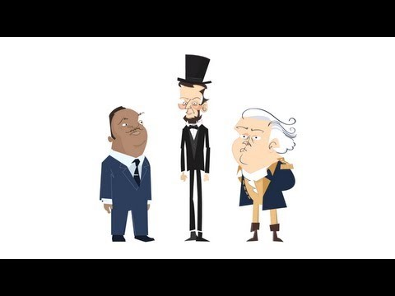
Application:
Cross-Curriculum Activity, Option 1
This video highlights values, character traits, and personality traits needed to achieve great things
“Virtue” refers to a morally good character trait.
How do the leaders show the following traits: bravery, compassion, dedication, and wisdom.

Slide 10
Application:
What is a virtue?
What virtue did George Washington demonstrate when he crossed the Delaware to attack the Hessians on Christmas Night?
What virtue did Sybil Ludington demonstrate when she rode 40 miles through the damp, cold night of April 1777?
Who is Beriah Green?
What virtue did President Lincoln demonstrates by his ability keeping the Union together?
You just heard about many history figures that were able to accomplish great deeds because of their "virtues." Describe a historical figure not mentioned in the video who you feel possessed a positive virtue and explain how that virtue helped him/her accomplish a "good deed."
How has history been shaped by the character traits of leaders?
How does identifying character traits help us better understand personality?
Cross-Curriculum Activity, Option 1

Slide 11
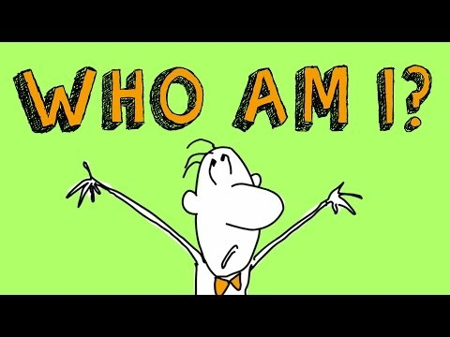
Application:
Cross-Curriculum Activity, Option 2

Slide 12
Closing Activity:
Think about someone in your life whose personality matches their career.
  What is this person’s career?
  What personality trait(s) makes this career a good match?
Classroom Discussion

