Slide 1
Checking in with Others: Perspectives
Learning Objectives:
Students will compare ideas about their identity with the perspective of others.

Slide 2

Kick-off Discussion:
What do you see?
(Image taken from http://brainden.com/face-illusions.htm)

Slide 3
Kick-off Discussion:
Exploring Perspectives
Now, what do you see?
Your point of view allows you to see things differently
(Image taken from http://brainden.com/face-illusions.htm)

Slide 4
Kick-off Discussion:
What are other things that might impact how we view a situation?
  Gender
  Age
  Experience
These factors may affect what we see or how we experience something.
People may view things differently, but it doesn’t mean one in right while the other is wrong.
Sharing Perspectives

Slide 5

Kick-off Discussion:
“You never really understand a person until you consider things from his point of view…until you climb into his skin and walk around in it.”
-Atticus, To Kill a Mockingbird
Sharing Perspectives

Slide 6
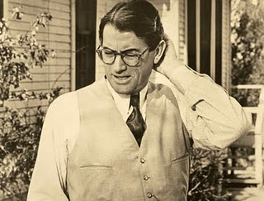
Kick-off Discussion:
“You never really understand a person until you consider things from his point of view…until you climb into his skin and walk around in it.”
-Atticus Finch, To Kill a Mockingbird
What do you think the author was trying to say?
Sharing Perspectives

Slide 7
Kick-off Discussion:
Who do you think was the owner of the shoe?
What did the owner look like?
How old?
What were their character traits?
What did they look like?
What did they do?
Sharing Perspectives

Slide 8
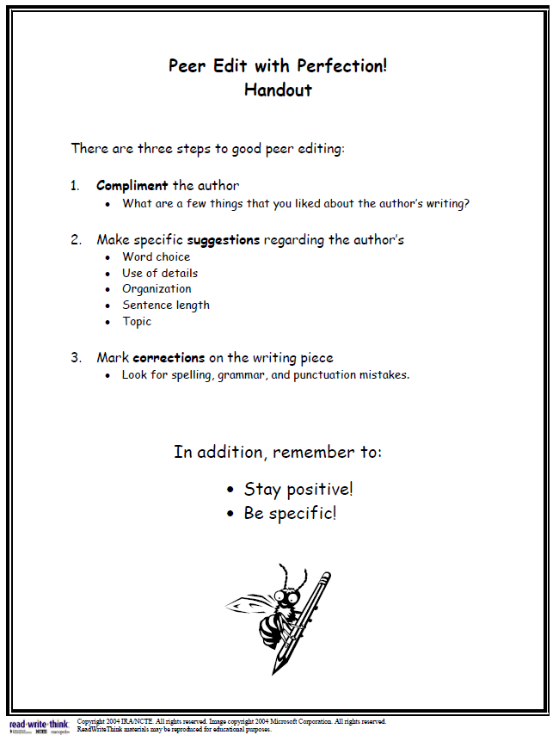
Map It Online Activity:
Peer Review Process

Slide 9
Map It Online Activity:
Each partner should give at least one additional perspective for each of the following questions:
Do you agree with my view of myself?
Do you have a different view than I do?
Use a conversation starter:
  “I agree that you are _________________ because ­­­­­­­­ ___________________. A suggestion is to add ___________________because _______________. “
Peer Review Process

