Slide 1
Reviewing Hard and Soft Skills
Learning Objectives:
Students will differentiate between hard and soft skills.
Students will evaluate their hard and soft skill ratings.
Students will respond appropriately to interview questions regarding their hard and soft skills.

Slide 2
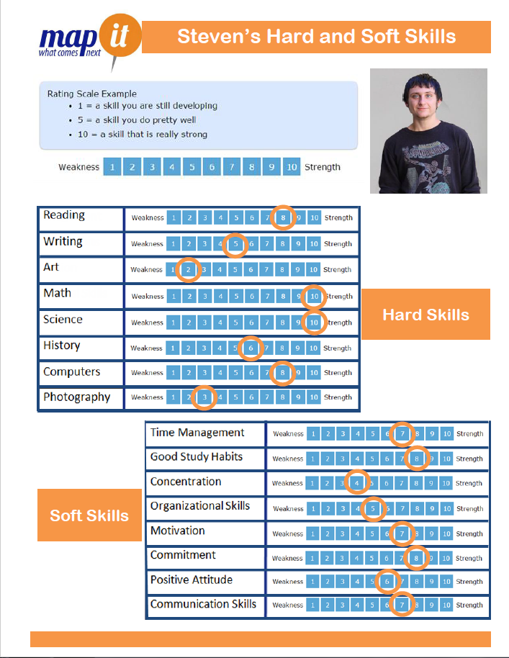
Kick-off Discussion:
Character Profiles

Slide 3
Kick-off Discussion:
Job Site | Job Title | Job Tasks
Pet Store | Assistant | Give food and water to animals, clean out cages, groom and exercise animals, help customers with questions, stock shelves, help with deliveries and keep store clean and tidy.
Movie Theater | Cashier Attendant | Greet customers, take & fill orders, pop popcorn, fill soda, serve other food items, operate cash register & credit card machine, answer questions, keep concession area clean and stock supplies.
Grocery Store | Bagger | Provide customer service, pack items in order, carry bags to customer’s car upon request, restock bag supplies, return and empty grocery carts, return unwanted items to appropriate area.
Which skills does Steven need to practice?

Slide 4
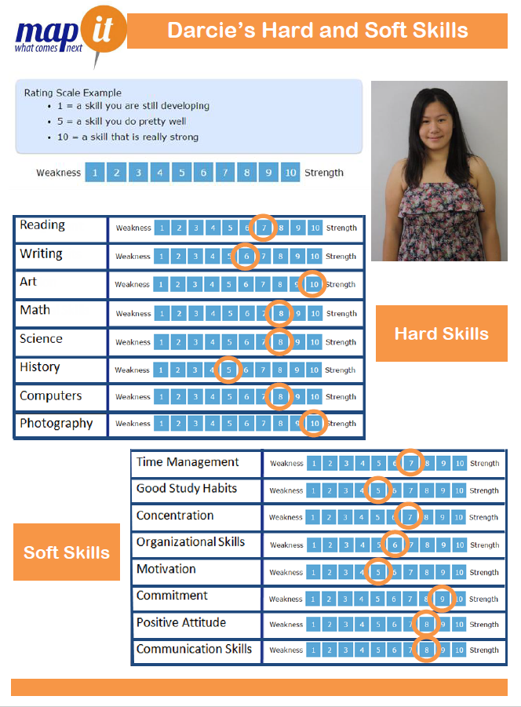
Kick-off Discussion:
Now at Darcie’s and Marissa’s profile

Slide 5
Kick-off Discussion:
Job Site | Job Title | Job Tasks
Pet Store | Assistant | Give food and water to animals, clean out cages, groom and exercise animals, help customers with questions, stock shelves, help with deliveries and keep store clean and tidy.
Movie Theater | Cashier Attendant | Greet customers, take & fill orders, pop popcorn, fill soda, serve other food items, operate cash register & credit card machine, answer questions, keep concession area clean and stock supplies.
Grocery Store | Bagger | Provide customer service, pack items in order, carry bags to customer’s car upon request, restock bag supplies, return and empty grocery carts, return unwanted items to appropriate area.
Which job would be a good fit? Be prepared to justify your answer

Slide 6
Kick-off Discussion:
How does knowing your strengths and weaknesses in both your hard and soft skills help you know yourself better?
Why does having a strong set of hard and soft skills create more career options?
Why do more people get fired because of weak soft skills compared to weak hard skills?
What is meant by the following statement, “A strength doesn’t stay a strength without work.”
Which job would be a good fit? Be prepared to justify your answer

Slide 7
Review Your Skills Profile Activity:
Share their highest and lowest ratings in hard and soft skills.
Are these skills strengths? Which of these strengths are hard skills? Which of these strengths are soft skills?
Which of these skills are weaknesses? Which of these weaknesses are hard skills? Which of these weaknesses are soft skills?
Which of their weaknesses will be a barrier in achieving future career goals?
Who can help them improve this skill or advise them on how to improve the skill?
Discussion prompts

Slide 8
Hard and Soft Skills Career Activity:
https://www.careeronestop.org/toolkit/careers/occupations/Occupation-profile.aspx?keyword=Carpet%20Installers&onetcode=47204100&ES=Y&EST=carpet+installers
Option 1, Carpet Installer Activity

Slide 9
Hard and Soft Skills Career Activity:
Option 2, Meet Kimberly Dodge, D.V.M
http://www.pepnet.org/resources/ag1

