Slide 1
Soft Skills
Learning Objectives:
Students will define a soft skill.
Students will identify soft skills from a list of traits, strengths and weaknesses.
Students will evaluate and rate a list of soft skills.

Slide 2
Kick-off Discussion:
Soft Skill Quiz
Measure how good your soft skills are by answering the following questions.
A CO-WORKER IS VERY NEGATIVE ABOUT YOUR IDEA(S) IN FRONT OF YOUR BOSS.
Do you...
a) Remind your co-worker of their last bad idea.
b) Say nothing. You will get even with this co-worker later.
c) Get angry.
d) Thank your co-worker and promise to consider their feedback.
Soft Skills Quiz
(MYTransitions Soft Skills Curriculum, http://montanayouthtransitions.org/soft-skills-curriculum/)

Slide 3
Kick-off Discussion:
YOUR BOSS HAS BEEN LESS TALKATIVE AND FRIENDLY LATELY.
Do you...
a) Avoid him/her.
b) Ask her feedback on your work performance.
c) Ask others if she has some personal problems going on.
d) Look for another job, you would rather quit than be fired.
Soft Skills Quiz
(MYTransitions Soft Skills Curriculum, http://montanayouthtransitions.org/soft-skills-curriculum/)

Slide 4
Kick-off Discussion:
YOU'VE FOUND OUT THAT YOU ARE THE TARGET OF A NASTY RUMOR AT WORK.
Do you...
a) Do nothing; rumors blow over eventually.
b) Find out who started the rumor and confront them.
c) Start a rumor about someone else to take the spotlight off yourself.
d) Become depressed and distracted.
Soft Skills Quiz
(MYTransitions Soft Skills Curriculum, http://montanayouthtransitions.org/soft-skills-curriculum/)

Slide 5
Kick-off Discussion:
A CO-WORKER THAT DOESN'T DO THEIR JOB AS WELL AS YOU DO IS PROMOTED TO A POSITION YOU HAD HOPED FOR.
Do you...
a) Start looking for another job—it is obvious you are not appreciated.
b) Make life difficult for your co-worker.
c) Ask the manager how you could be a stronger candidate next time.
d) Pout, and hope someone notices your hurt feelings.
Soft Skills Quiz
(MYTransitions Soft Skills Curriculum, http://montanayouthtransitions.org/soft-skills-curriculum/)

Slide 6
Kick-off Discussion:
YOU ASKED FOR VACATION LEAVE TWO WEEKS IN ADVANCE AND DIDN'T GET IT.
Do you...
a) Take sick days and be gone anyway.
b) Quit, because your boss isn't flexible
Visit with your boss and review vacation policies and as well as dates that vacation leave is available.
d) Complain to your co-workers about how unfair your boss is.
Soft Skills Quiz
(MYTransitions Soft Skills Curriculum, http://montanayouthtransitions.org/soft-skills-curriculum/)

Slide 7
Kick-off Discussion:
YOU MAKE A MISTAKE THAT COULD COST THE COMPANY A LOT OF MONEY.
Do you...
a) Tell your boss immediately and ask for advice on minimizing the damage.
b) Resign as quickly as possible.
c) Try to cover up the error, hoping nobody finds out.
d) Blame others for their part; you won't take the heat alone.
Soft Skills Quiz
(MYTransitions Soft Skills Curriculum, http://montanayouthtransitions.org/soft-skills-curriculum/)

Slide 8
Kick-off Discussion:
A CO-WORKER OFTEN GOSSIPS ABOUT MANAGEMENT AND IT'S HARD NOT TO LISTEN!
Do you...
a) Listen eagerly, but never repeat what you hear.
b) Tell her what you think of her lack of loyalty.
c) Let your boss know your co-worker is gossiping.
d) Tell her you are not interested, and change the subject quickly.
Soft Skills Quiz
(MYTransitions Soft Skills Curriculum, http://montanayouthtransitions.org/soft-skills-curriculum/)

Slide 9
Kick-off Discussion:
YOUR BOSS GAVE YOU A VERBAL REPRIMAND FOR TALKING ON YOUR CELL PHONE AT WORK AFTER YOUR MOM CALLED YOU TO ASK YOU TO BRING PIZZA HOME FOR DINNER.
Do you...
a) Explain that it was just your mom and it is not a big deal.
b) Apologize and review technology policies at work if unsure what is allowed.
c) Complain to customers nearby about how unfair the employer is and that he lives in the dark ages.
d) Call the pizza place and order the pizza for your mom and then go back to work.
Soft Skills Quiz
(MYTransitions Soft Skills Curriculum, http://montanayouthtransitions.org/soft-skills-curriculum/)

Slide 10
Kick-off Discussion:
How are your soft skills?
Soft Skills Quiz
(MYTransitions Soft Skills Curriculum, http://montanayouthtransitions.org/soft-skills-curriculum/)

Slide 11
Kick-off Discussion:
Soft Skills Quiz
Hard Skills?
How to work camera
How to frame your shot
Editing skills
Certification/degree
Marketing skills
Soft Skills?
People skills: communicating, listening
How to coordinate large groups and make clients feel comfortable

Slide 12
What skills are needed to be a news reporter?
Hard Skills?
Soft Skills?

Slide 13
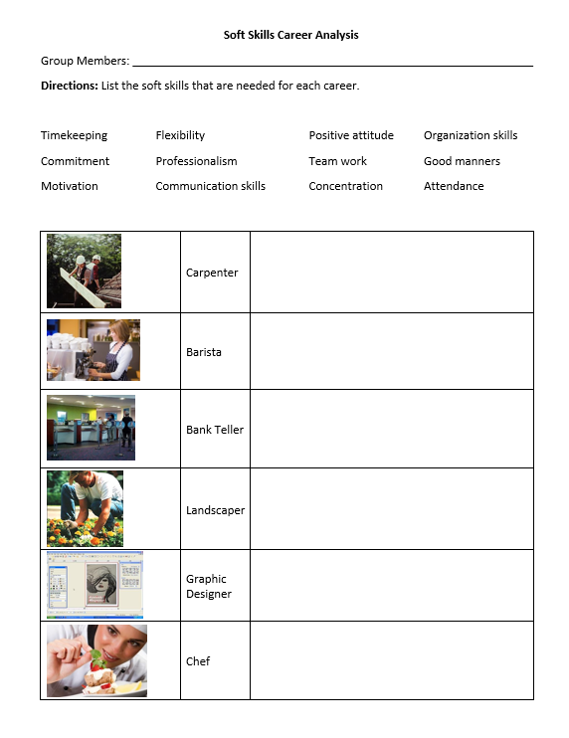
Your Turn:
What hard skills are needed for each job?

