Slide 1
Strengths
Learning Objectives:
Students can define the meaning of “strength”.
Students can recognize strengths in others.
Students can identify five of their personal strengths.

Slide 2
Kick-off Discussion:
Do you agree or disagree?
Having strength refers only to physical strength.
Everyone has the same set of strengths.
A personal strength may include character traits such as friendliness, organization, or compassion.
You may need to work hard at developing a strength.
All jobs require workers to be strong in math.
All jobs require workers to be strong communicators.
Agree or Disagree? Why?

Slide 3
Kick-off Discussion
[Insert photo of person used in discussion on Traits]
What strengths does this person have?
Do these strengths help this person do their job?

Slide 4
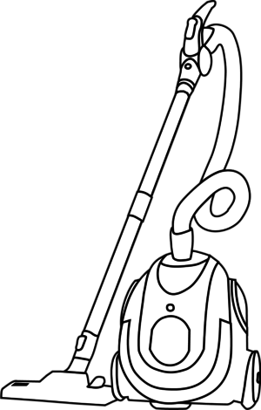
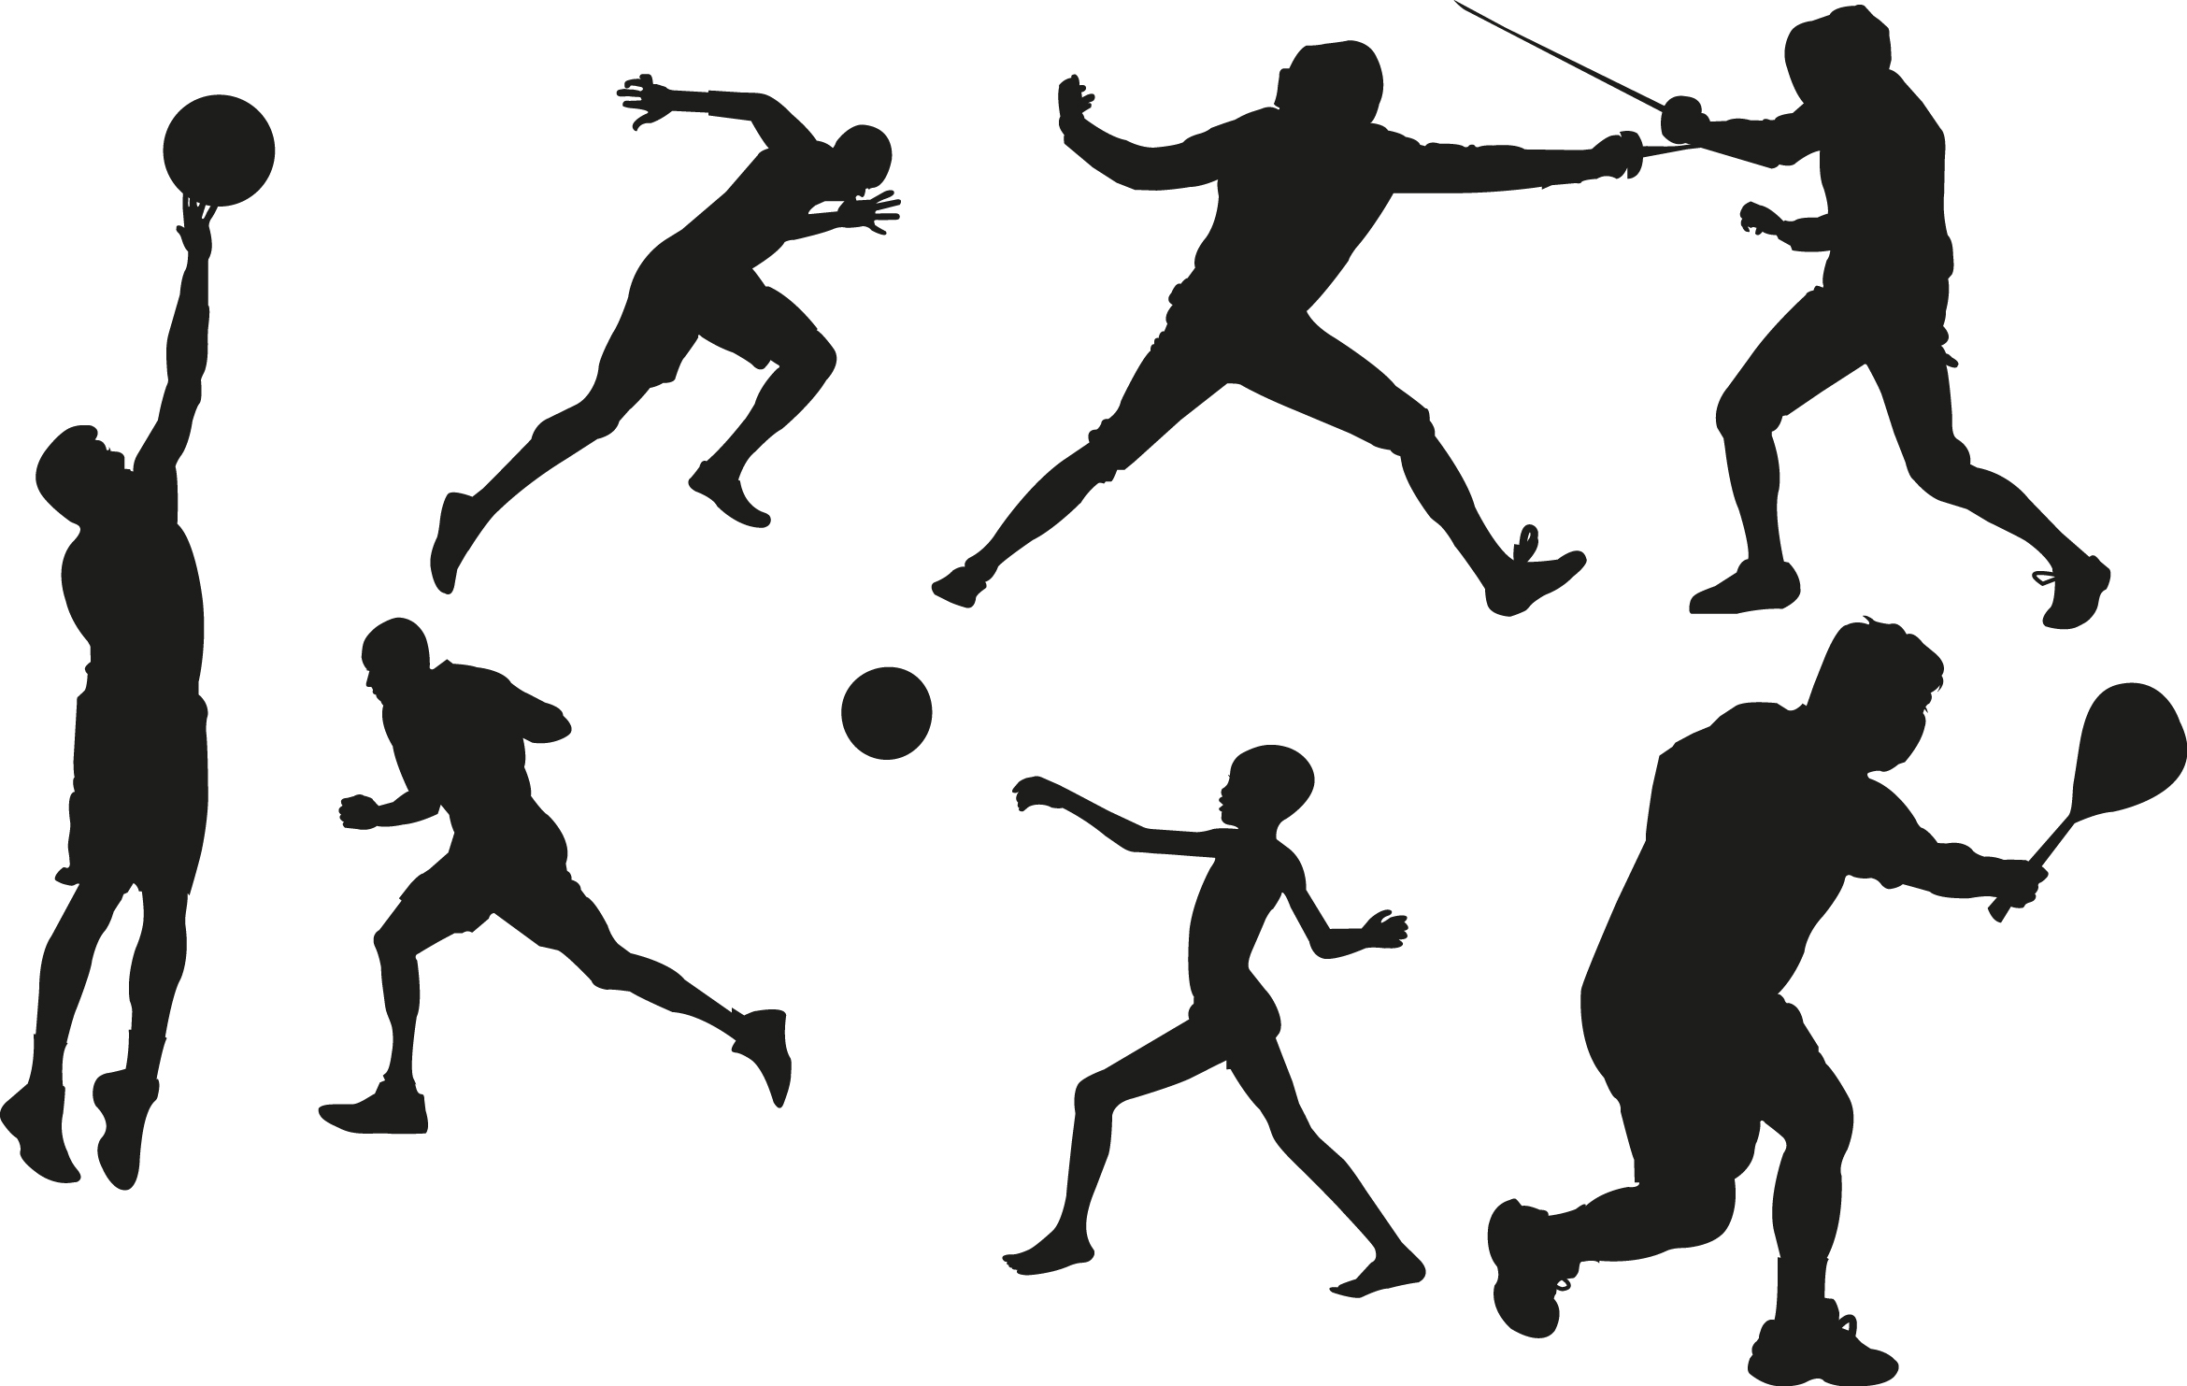
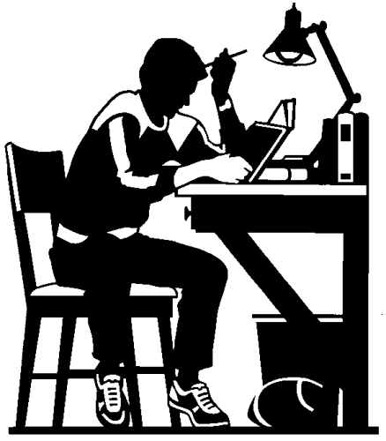
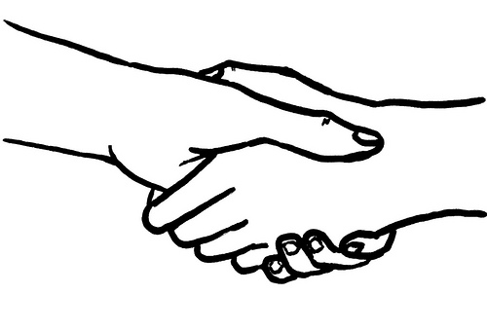
Classroom Discussion:
What are your strengths?
What are your strengths at home, school, or in the community?
How did you become good at your strength? Was is natural or did you have to work hard?
Why is it important to identify personal strengths while looking for a job?

Slide 5
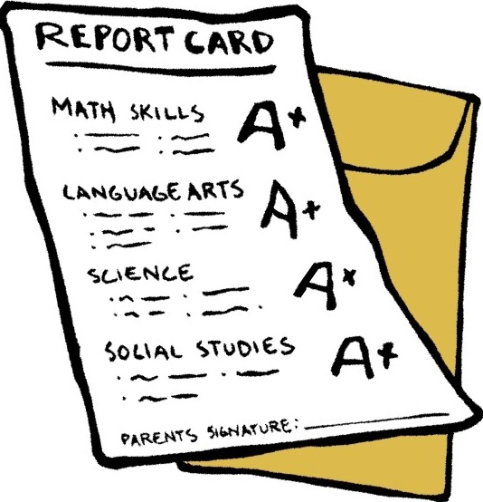
Classroom Discussion:
When did you realize your skill or character trait was a strength?
At what point does a skill or trait become a strength?
What are your strengths?

Slide 6
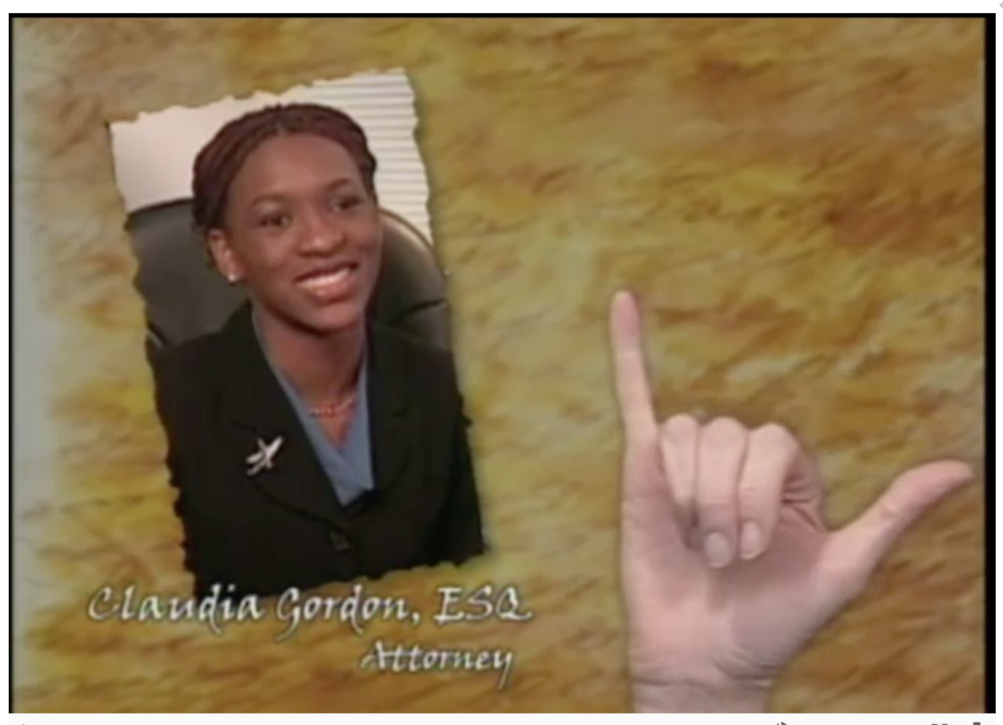
Classroom Discussion:
Meet Claudia Gordon

Slide 7
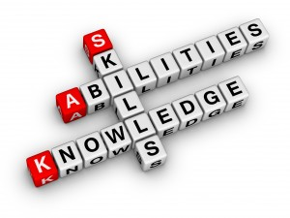
Classroom Discussion:
What are some of Claudia’s strengths?
Are her strengths natural or did she have to work hard?
What important information does her science teacher offer?
How does Mrs. Ashely rate Claudia’s skills?
Other things you learned from Claudia?
Meet Claudia Gordon

Slide 8
Application Activity:
Teachers: Choose a Multiple Intelligence Survey:
Getting to Know You, by Laura Candler
Multiple Intelligence Assessment, by Literacy Works
Multiple Intelligence Self-Assessment, by Edutopia
Multiple Intelligence Test for Children, by lovetoknow
Learn more about the 8 Intelligences through video:
8 Intelligences-Theory of Multiple Intelligences Explained (4:15)
Multiple Intelligences (4:32)
Visual Resources of Multiple Intelligences:
Multiple Intelligences- Howard Gardner, by Australian National Curriculum
Multiple Intelligence Theory

Slide 9
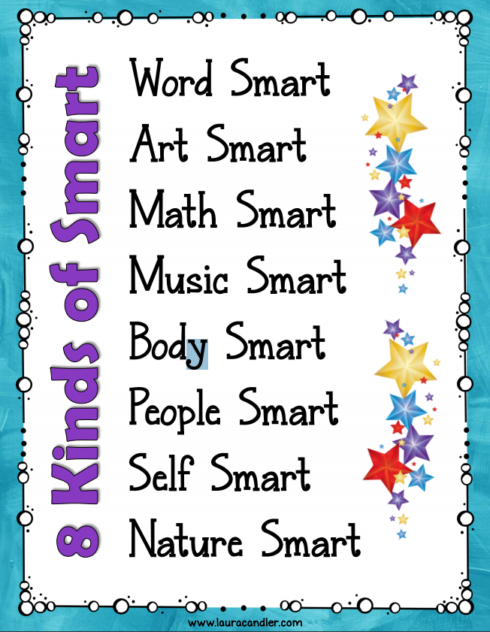
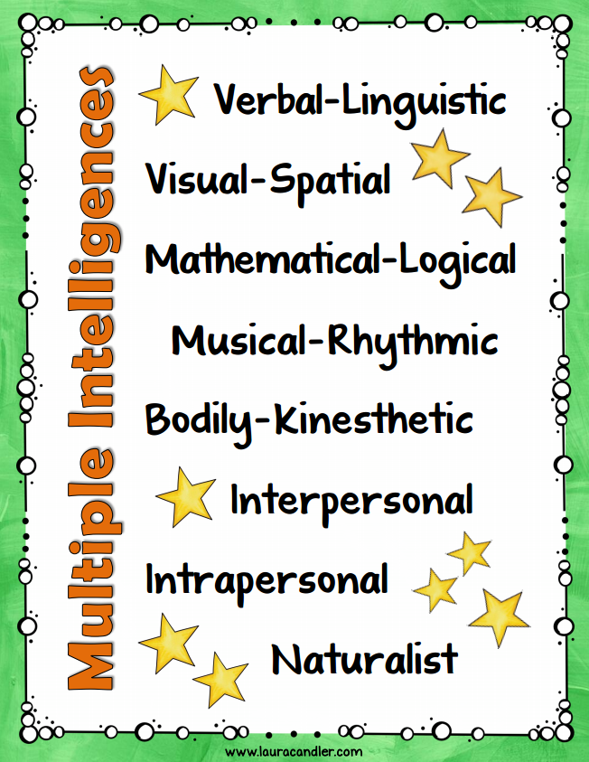
Application Activity:
We each have individual skills and there are a variety of ways to demonstrate our knowledge and skills.
Multiple Intelligence Theory
(Images retrieved from www.lauracandler.com)

Slide 10
Application Activity:
Multiple Intelligence Theory
(Image retrieved from http://australiancurriculumf-6resources.blogspot.com/2013/04/gardner-multiple-intelligences.html)

Slide 11
Application Activity:
Your results:
Do your results surprise you?
Do you agree?
Did you already know this about yourself?
Do you disagree with anything?
Reminder: Scoring low in a particular area doesn’t necessarily mean that it’s an area of weakness.
Multiple Intelligence Theory

Slide 12
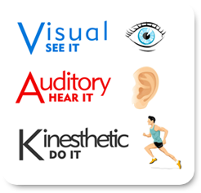
Application Activity:
Understanding how one learns best, can help support success in different settings.
Teachers: Choose a Learning Style Inventory:
Got Style? Understanding your own way of Learning
Learning Styles Inventory, Teaching and Learning Center
C.I.T.E Learning Styles Instrument, by Transition Coalition
Learning Styles Inventory (LSI)
Learning Styles Questionnaire, by NC State University
Learning Styles Inventory

Slide 13
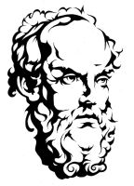
Application Activity:
“Know Thyself”
-Socrates
What do you think Socrates meant by this phrase?
Why is it important to understand who you are as a learner? Your learning strengths?
Why is it important to be able to explain how you learn?
How does understanding one’s learning style help in school or in our relationship with others?
How can this understanding create a positive view of who you are?
Learning Styles Inventory

Slide 14
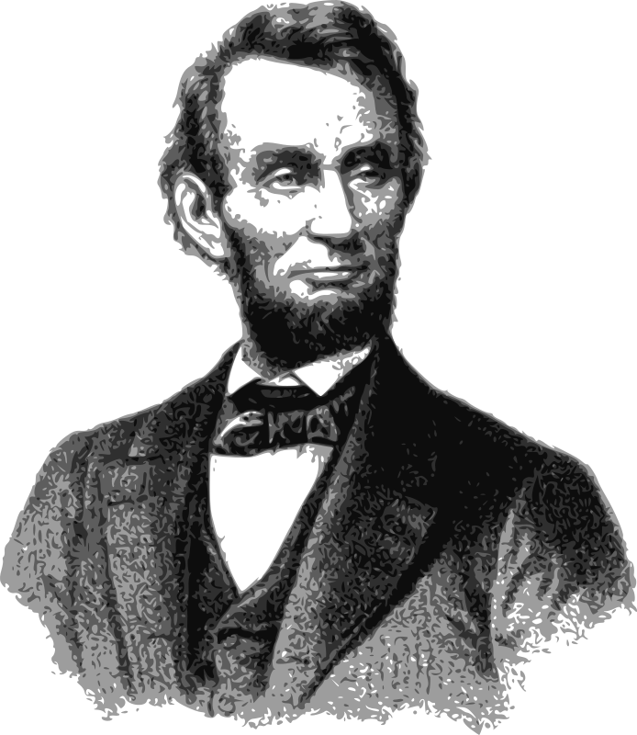
Cross Curriculum Activity:
Abraham Lincoln,
16th President of the United States
Honest Abe, Common Lit
Biography President Abraham Lincoln, by Ducksters Education Site
Video Biography of Abraham Lincoln: Meet the President for Kids (4:08 with CC)
Abraham Lincoln

Slide 15
Cross Curriculum Activity:
Grew up in Kentucky and was from a poor family.
Self-educated and became a lawyer.
Elected to the Illinois House of Representatives where he worked for 8 years before being elected president.
Nickname was “Honest Abe” and many people believe that President Lincoln was one of the most honest presidents.
16th president of the United States.
President during a difficult time for America during the Civil War. It was a time when the country was divided; the north and south had very different views (perspectives) on what they wanted and what was important to them.
Opposed to slavery and this did not make him popular with everyone.
Physical characteristics include his height of 6 feet 4 inches (the tallest president ever) and he had a full beard.
Abraham Lincoln

Slide 16
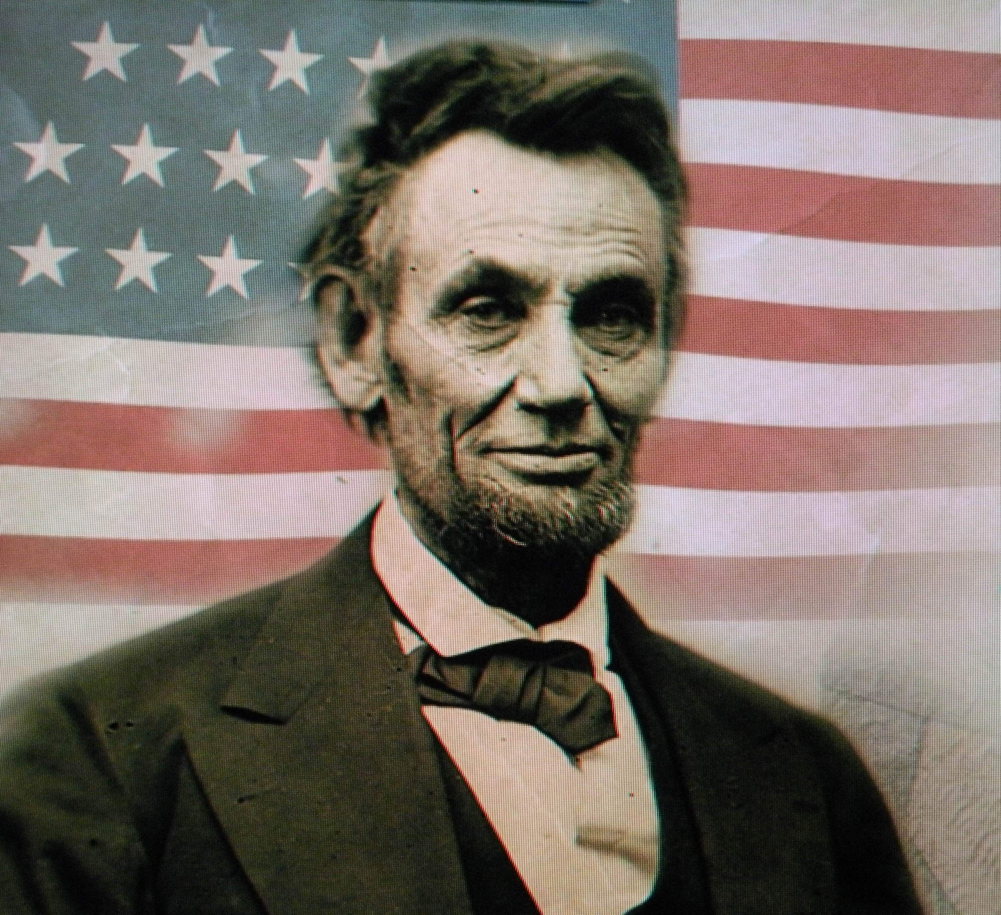
Cross Curriculum Activity:
Abraham Lincoln
Why do you think Lincoln is considered one of the greatest presidents?
What he might have been like as a person?
What are some of his strengths?
How did his strengths benefit him as the 16th president?

