Slide 1
Student-driven IEP
Learning Objectives:
Students will understand their role and purpose of the IEP meeting.
Students will demonstrate self-determination and self-advocacy skills during their IEP meeting.

Slide 2
Student-driven IEP:
“Why is This Cake on Fire”
(Van Dyke, Martin, & Lovett, 2006)
  “Imagine being a small child, and hearing your parents talk about ….”
  (Retrieved at http://www.nssed.org/wp-content/uploads/2012/04/Why-is-this-cake-on-fire.pdf)
Kick-off Activity

Slide 3
Student-driven IEP:
Why is This Cake on Fire? Discussion Questions:
Is the scenario similar to your IEP experience? Why or why not?
What is your first memory of the IEP planning process? How old were you?
How has your role in the IEP process changed over the years?
How would you rate your previous IEP experience: average, good, or excellent? Why?
Do you consider yourself an active player on your IEP team or on-the-sidelines? Why?
Who on your IEP team do you connect most with? Why?
Classroom Activity

Slide 4
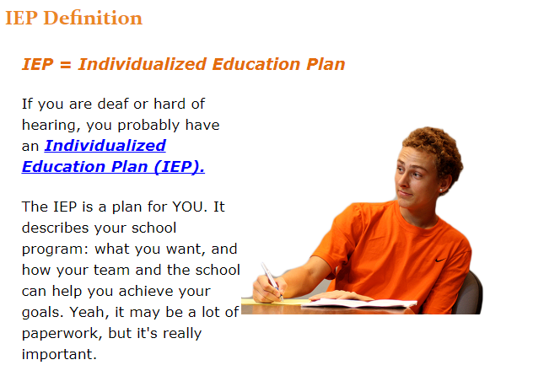
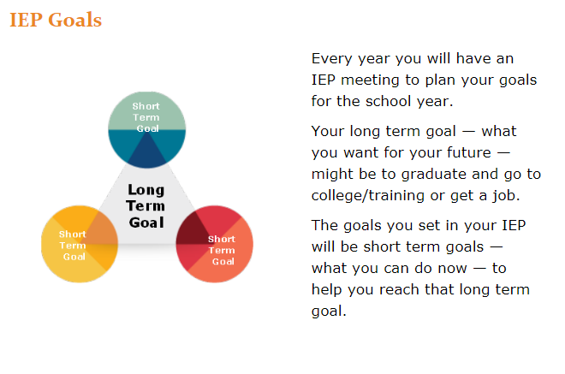
Map It Online Activity:
Individualized Education Plan

Slide 5

Student-driven IEP:
Complete the following I’m Determined Student Rubric for IEP Participation: http://www.imdetermined.org/files_resources/99/studentrubricforiepparticipation.pdf
This rubric is designed to self-evaluate your IEP awareness, participation and knowledge, as well disability awareness, rights and responsibilities, and soft skills.
Self-Assessment

Slide 6
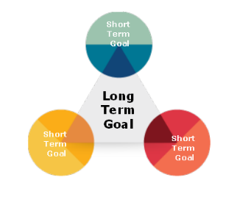
Student-driven IEP:
Complete the Short Term Goal Activity handout by assessing your short term goals related to your long term goals.
Start by reviewing the definition of both types of goals: long term goals are what you want for the future (graduate from high school, get a job, attend college/training program, live independently), and short term goals are goals set in the IEP that help you reach your long term goal.
After worksheets are complete, divide into small groups (or pairs) to discuss responses. What are some similarities and differences?
Short Term Goal Activity

Slide 7
Map It Online Activity:
Discuss Brandon’s reflection of his IEP meeting.
What are the benefits of running your own IEP meeting?
Review the 5 tips to remember when leading your IEP:
  The reason for the IEP meeting: to develop goals for next year.
  Know yourself and what you want: the better you know yourself, the better your goals will be.
  Importance of team support: listen to team members’ perspectives and feedback.
  Attitude is important: lead the meeting with a positive attitude to develop great goals.
  Being a good self-advocate takes practice: the first IEP meeting you lead may not be easy, but there are ways to improve for your next meeting.
Review the student led IEP checklist.
Leading Your IEP

Slide 8
Student-driven IEP:
Review your Map It: Your Team list. Ask yourself the following questions and edit Your Team if needed:
  Do I need to update my circle?
  Have team members changed?
  Have close friends or family changed?
  Do I need to add new people from the community or work-based learning experiences?
Next, interview members of your IEP team to learn more about their profession, or background, and how they might be able to support post-secondary transition. Ask the following questions:
  Share a little about your profession and your work with students.
  Explain your role in the IEP process.
  How many IEP meetings have you attended?
  What type of input do you offer during the meeting?
  What can be done to improve the IEP experience?
IEP Team Member Interview Activity

Slide 9
Student-driven IEP:
Each of you will be divided into a small group and assigned a role such as student, principal, teacher, parent, friend, counselor, psychologist, audiologist, speech language pathologist, or VR counselor.
In your group, role play a student-driven IEP meeting where the student leads an IEP meeting based on the Map It checklist.
Practice using support materials such as a Visual Resume, information from their Career Portfolio, or a formal IEP presentation. You can use the PowerPoint template provided or create your own.
Role play activity will be graded on:
  Being prepared with your presentation
  Following the Map IT checklist
  Dressing and acting professionally
  Demonstrating soft skills
  Exhibiting self-determination skills
  Self-advocating SMART goals/steps
  Post-meeting self-evaluation and accepting constructive feedback from teacher
Role Play Preparation Activity

Slide 10
Student-driven IEP:
Gather materials to support the IEP planning process or create a visual presentation that follows the Map It checklist to help guide the meeting.
  For PowerPoint access the It’s All About Me: Helping Students Create PowerPoint Presentations for IEP Meetings from the I’m Determined project, http://www.imdetermined.org/educators/resources/#*.
  Other support materials may include:
    Letters/notes from teachers regarding courses
    Work-Based Learning Experience Self-Reflection Worksheet(s)
    Visual Resume, Career Portfolio, or Resume to share work related experiences, job interest, skills, and qualifications
    MapIt completed materials including team members, strengths, weakness, hard and soft skills, personality, values, and disability awareness
    Results from completed Interest Inventories, Learning Style inventories, Multiple Intelligences Assessments, and other Personality Assessments
Once the date for the IEP has been determined, send invites to IEP team members.
Before the meeting, meet with your teacher to determine what information should be prioritized and practice leading the meeting, following an agenda, and using soft skills.
Synthesis Activity

Slide 11

Student-driven IEP:
Exit Ticket
In one sentence, state the purpose of the Individualized Education Plan.
Check off the following self-determination and self-advocacy skills demonstrated during the IEP meeting:
  decision making,
  choice making,
  problem solving,
  sharing perspective, wants, needs, interests, preferences, and goals.

