Slide 1
Team
Learning Objectives:
Students will identify members of their IEP team or transition team.
Students will state the roles of the members on their team.

Slide 2
Kick-off Discussion:
Circle of Support
Henry’s Story: https://youtu.be/8YfliBKMeYA

Slide 3
Kick-off Discussion:
Who is in Henry’s circle?
Why is it important to include people with different skills and knowledge on the team?
How is a “circle of support’ like a team?
Imagine Henry as the team owner
Other people as players/team members
What is needed to make a great team?
Circle of Support

Slide 4
Classroom Discussion:
Circle of Support

Slide 5
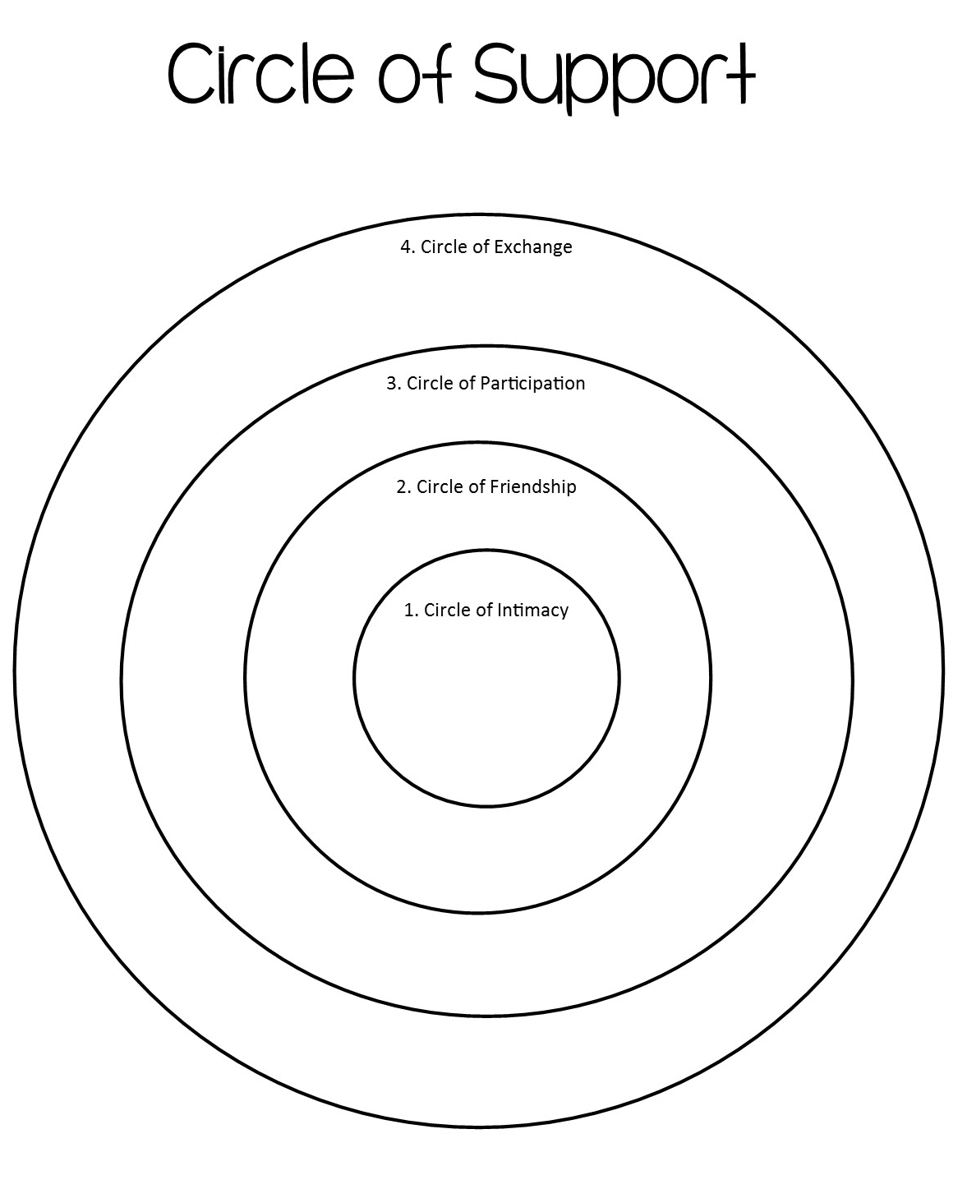
1. Circle of Intimacy- Those closest to us that we interact with on a daily basis. May include family and friends (and animals or objects).
2. Circle of Friendship- Those we are close with, but may not see on daily basis. May include other friends and relatives.
4. Circle of Exchange- Those who are paid to be in our life. May include boss, job coach, teachers, doctor, counselor, or principal.
3. Circle of Participation- Those who we know from the community. May include teams, clubs, school friends, or co-workers.

Slide 6
Classroom Discussion:
Is there anyone else I should consider to be part of my circle?
Why do you think it’s important to include people in each circle?
How is my circle of support similar to a good team?
What traits would I look for in a good team?

Slide 7
IEP Dream Team Activity:

Slide 8
IEP Dream Team Activity:

Slide 9
IEP Dream Team Activity:
Who makes up your IEP Dream Team?
Who is the most important person on your team?
Why it is important to include people from all circles on your team?
How do these people play different roles in your life?
Is your Dream Team the same as your peers?
Do you think it would be the same 3 or 5 years from now? Why?

Slide 10
Team Career Activity:
Watch the film (or parts of) Teamwork in Hospitality from the Described and Captioned Media Program (DCMP), https://dcmp.org/media/6521-teamwork-in-hospitality/stream?digest=32859 (26:00).
Take notes on team structure, teamwork, roles and responsibilities, communication, and feedback.
What are the various jobs in hospitability industry?
What are the roles of each job?
Why is it important to have smooth teamwork in hospitality?
What are characteristics of an effective team?

