Slide 1
Traits
Learning Objectives:
Students will define a trait; physical trait and character trait.
Students will identify five of their physical or character traits.

Slide 2
Kick-off Discussion:
[Insert image/video of a person students know well (yourself, school staff, famous/historical person, sports figure, artist, actor, etc. This person will be used in next two lessons].
What makes this person unique, or special?
What are some ideas about this person’s:
Strengths
Talents
Weaknesses
Personality characteristics
Physical characteristics

Slide 3
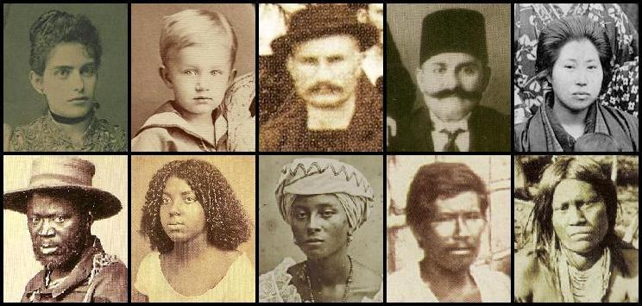
Classroom Discussion:
Look around the room at peers:
Recognize the different physical traits you see: long or short hair, color of hair, dimples, smiles, eye color, tall or short, color of skin, freckles…
These are Physical Traits

Slide 4
Classroom Discussion:
Now, think about how different peers act:
Friendly, moody, grumpy, happy, shy, smart, outgoing, helpful, funny, creative…
These are Character Traits

Slide 5
Map It Practice Online Activity:
Trait: a characteristic, feature, or quality of a person
There are 2 types of traits:
Physical Traits
Character (or personality) Traits
Additional Practice

Slide 6
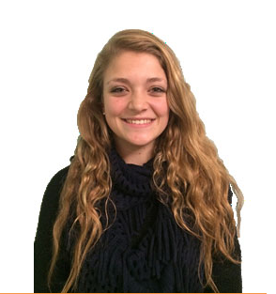
Map It Practice Online Activity:
Additional Practice
Add4-5 physical traits for each person.

Slide 7
Map It Practice Online Activity:
Additional Practice
What character traits do you notice?

Slide 8
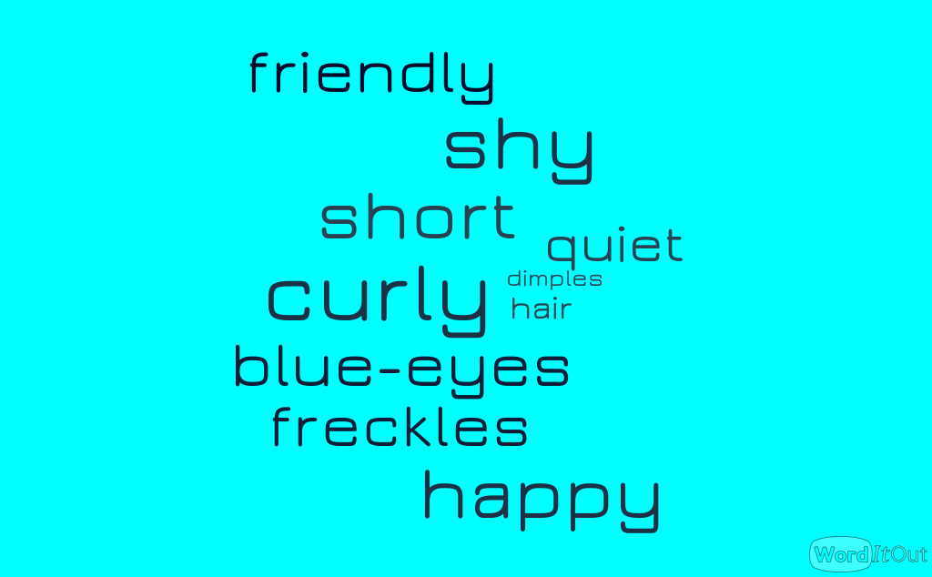
Individual Traits Extension Activity:
Create your own visual word cloud by entering your list of traits in a word cloud generator. Choose one here:
http://www.edudemic.com/9-word-cloud-generators-that-arent-wordle/
Get creative, choose your font, size, orientation, and background color…make it you!
Word Clouds

Slide 9
Application Activity:
Watch a short video from the pepnet 2, Achieving Goals! Career Stories of Individuals Who are Deaf and Hard of Hearing: Ambitious Achievers- Vol 5: http://www.pepnet.org/resources/ag5
Meet Rosa Lee Gallimore (a Performing Artist)
Matthew Baker (a caterer)
What physical traits did you notice?
What character traits did you notice?
What traits would be important for each of these careers?
Traits for Careers Video

Slide 10
Synthesis Activity:
[Insert image of the character you will be discussing]
Cross Curriculum
Discussion Prompts:
What were the character’s action in the story?
What personality traits does the character have?
What text evidence helps you draw conclusions about the character’s traits (based on what a character says, thinks, feels, and does)?

