Slide 1
Allison Siri

Slide 2
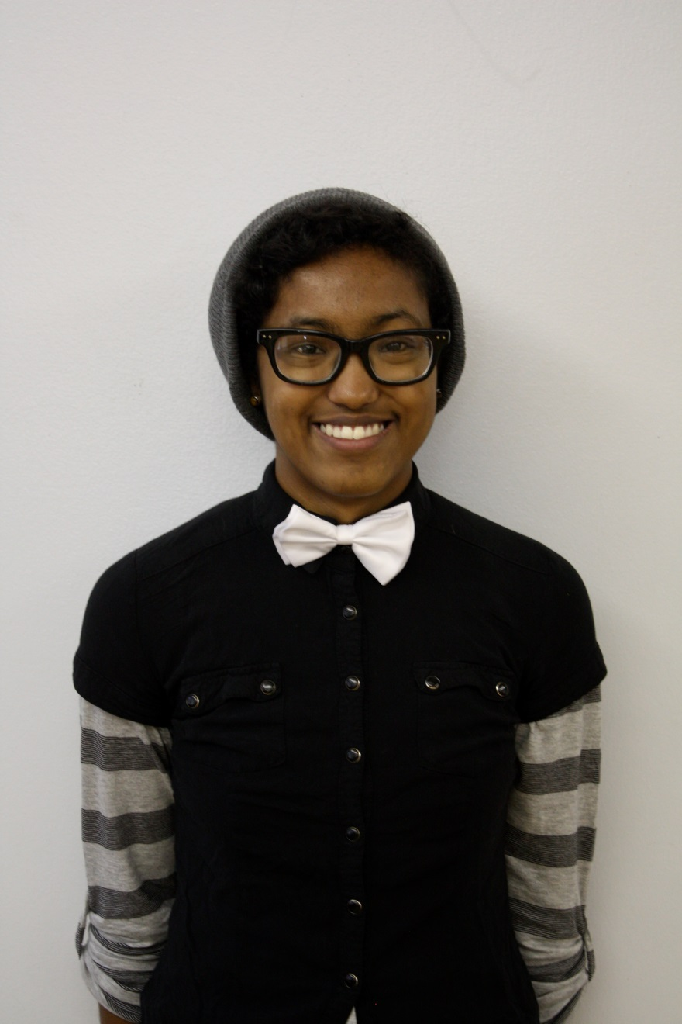
I am a sophomore in high school and plan to attend college when I graduate.

Slide 3
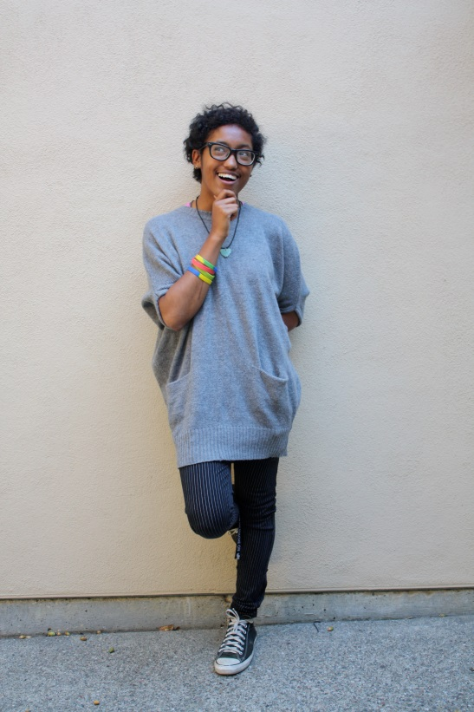
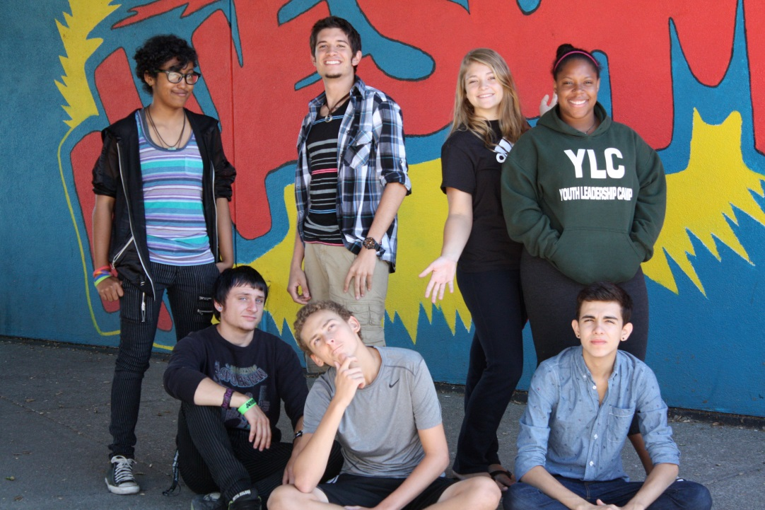
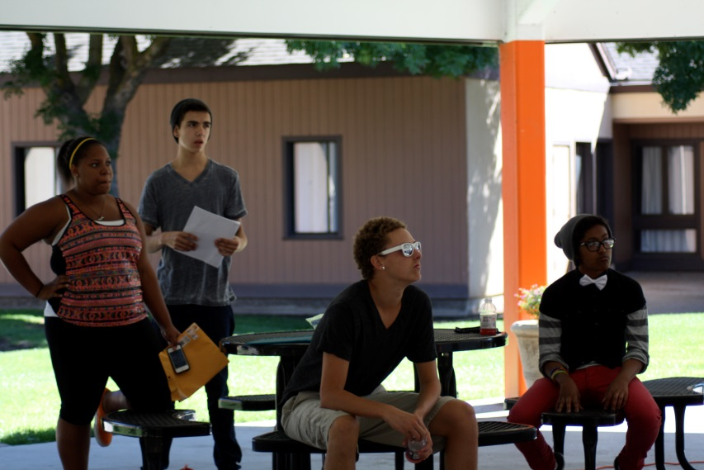
I love to travel and meet new people. I enjoy acting and being in front of large crowds.
I don’t believe in giving up when others tell me I can’t do something.

Slide 4
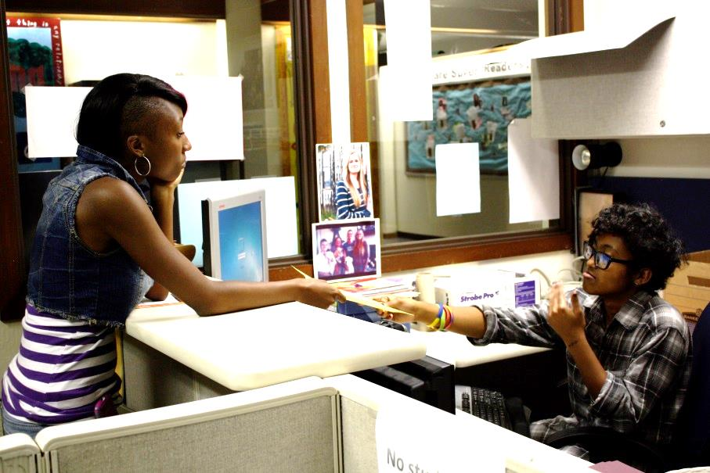

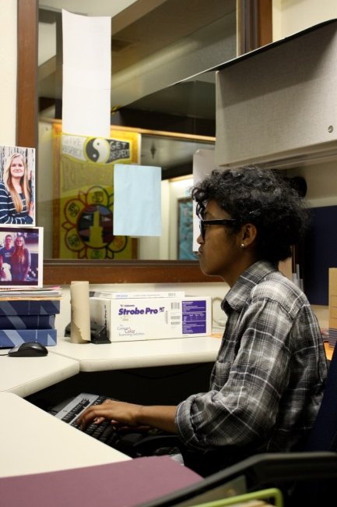

This year I volunteered in the school’s front office to gain work experience. My job duties included:
Organizing files
Collecting attendance records
Planning the graduation ceremony
Making copies
Answering phone calls

Slide 5
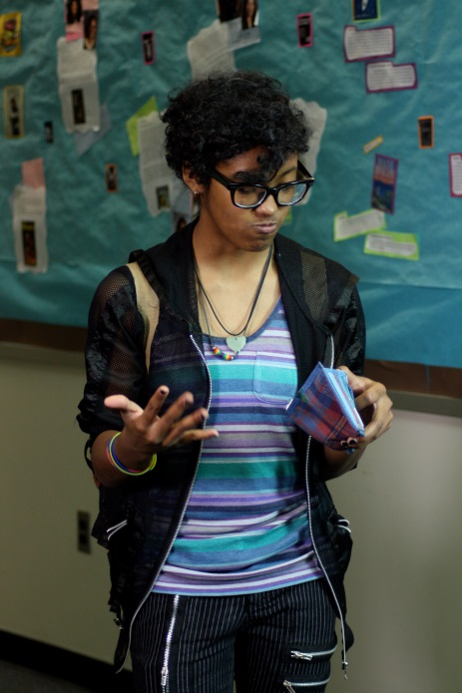
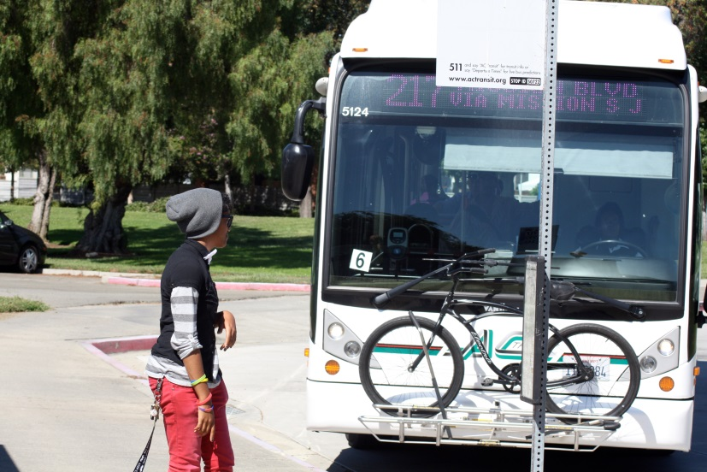
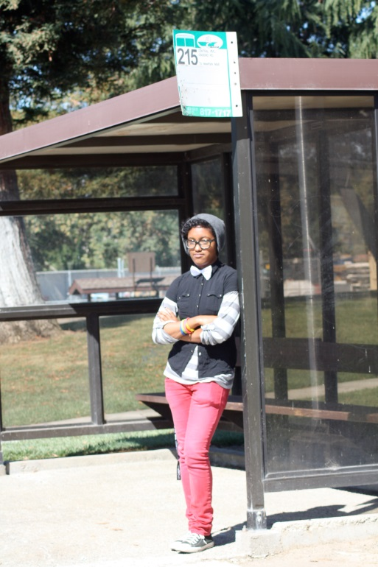
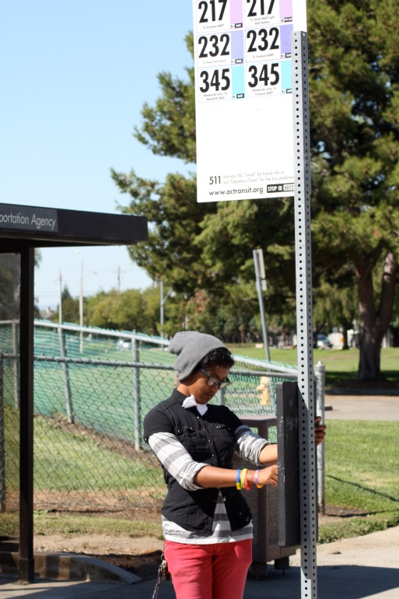
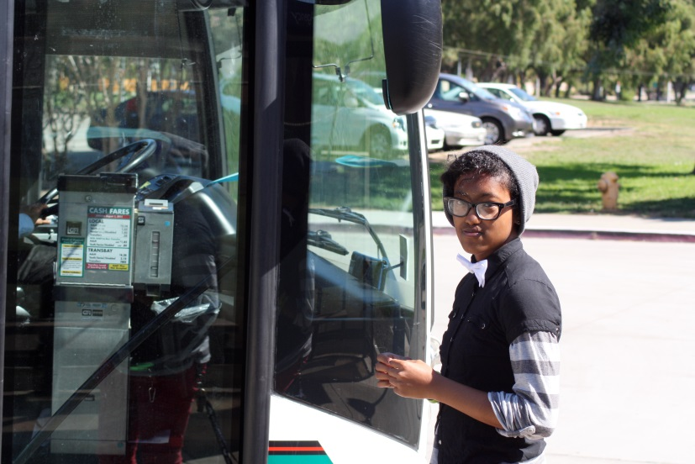
I know how to manage my money and how to use public transportation independently. I know how to plan my trip to make sure I arrive to work on time.

Slide 6


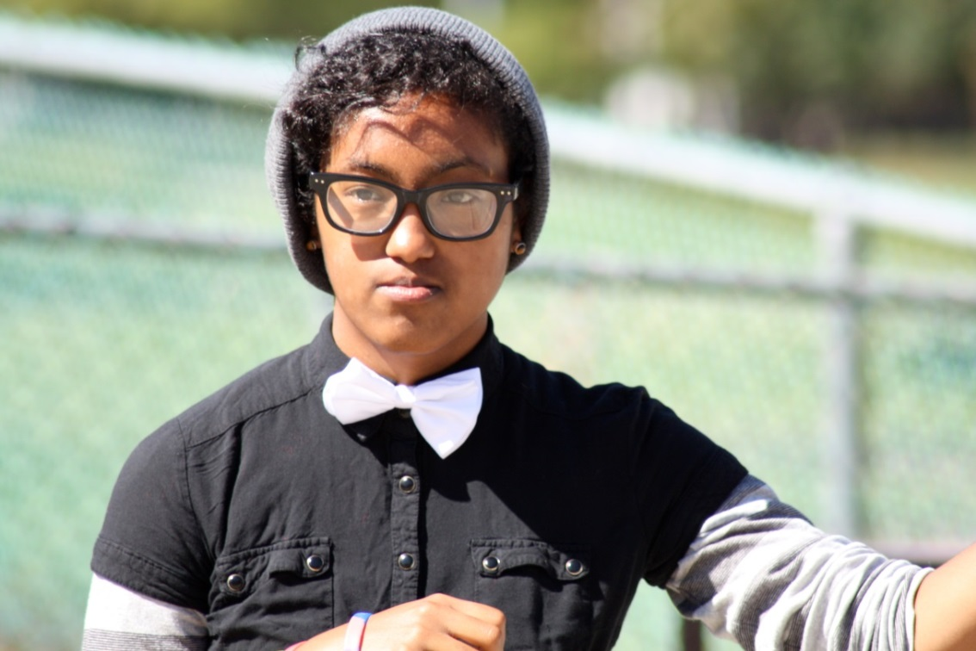

Working with others would be a good fit for me because I have these skills:
Hard worker.
Creative and like to try new things.
Good at communicating with other people.
I know English, American Sign Language, and Tactile Sign Language
I like to solve problems and support others.

