Slide 1
Weaknesses
Learning Objectives:
Students will define a weakness.
Students will identify five of their personal weaknesses.

Slide 2


Kick-off Discussion:
Do you agree or disagree?
Having weakness refers only to physical strength.
A weakness cannot become a strength.
A personal weakness may be a character trait such as being shy.
You can change a weakness into a strength through practice.
Agree or Disagree?
Why?

Slide 3
Kick-off Discussion
[Insert photo of person used in discussion on Traits and Strengths]
What weaknesses does this person have?
How would these weaknesses affect this person’s ability to get hired or keep their job?

Slide 4
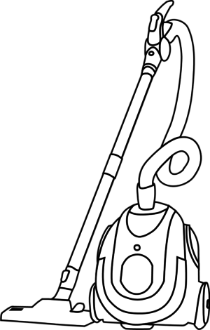
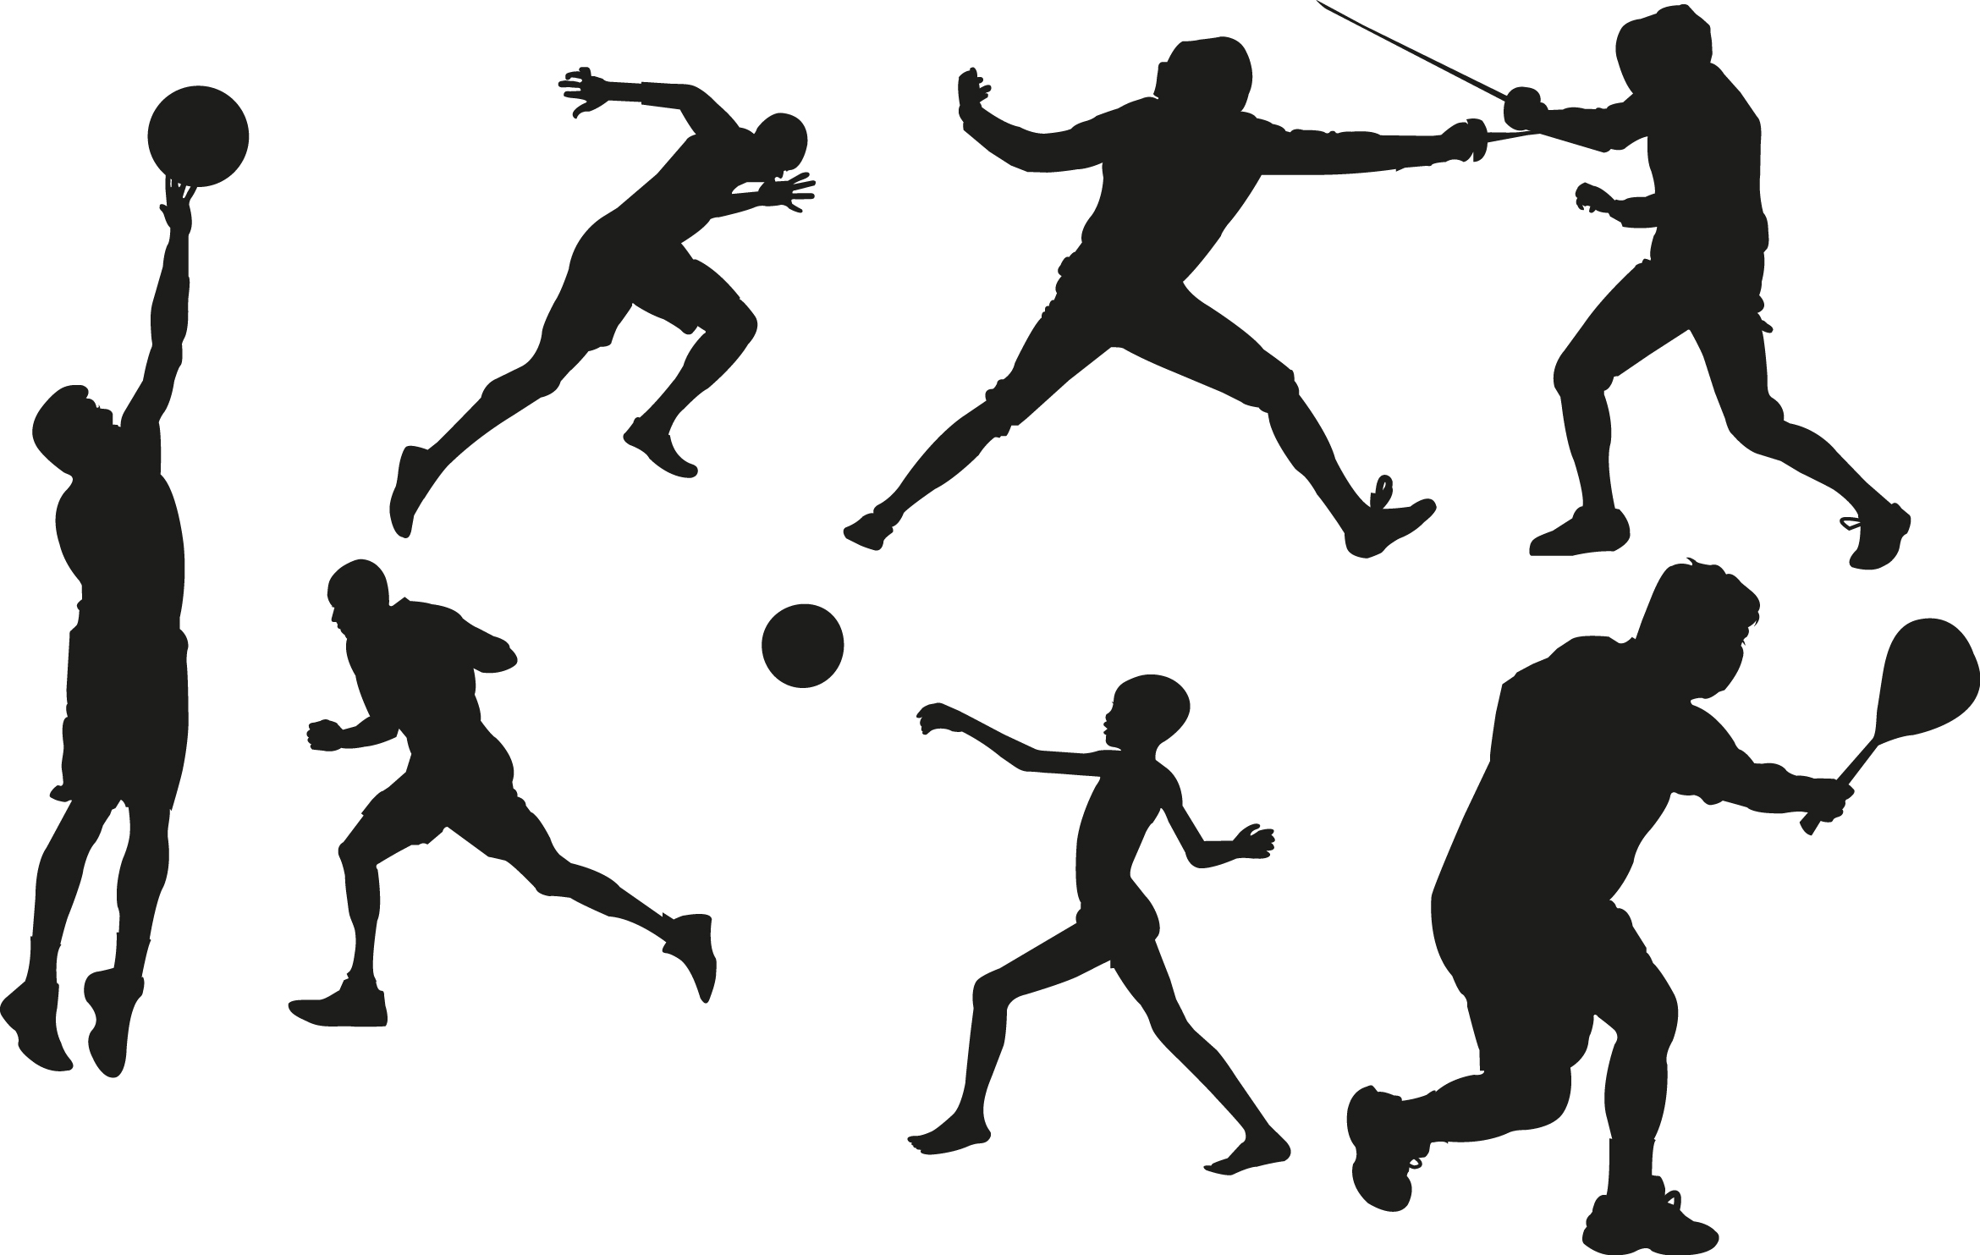


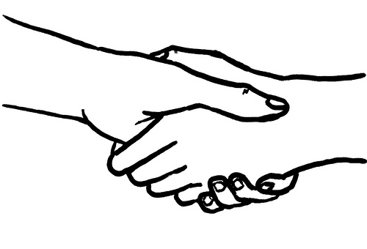
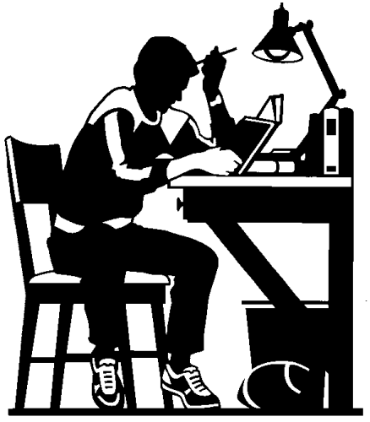
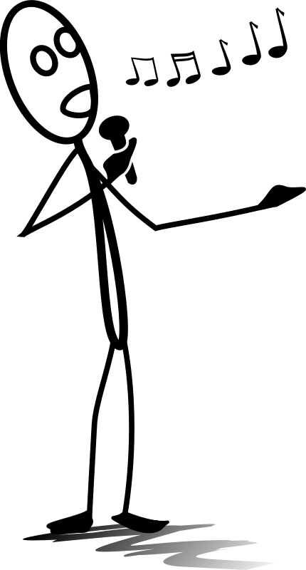



Classroom Discussion:
What are your weaknesses?
Look at your “Individual Strengths Activity” handout:
  What is the opposite of each strength?
The opposite of a strength is a weakness (with a grey zone in between).
We all have weaknesses.
With smart planning, we can work on our weaknesses to achieve goals.
Research shows that we can change, or train, our brains to be stronger in strengths and weaknesses with motivation and practice.

Slide 5
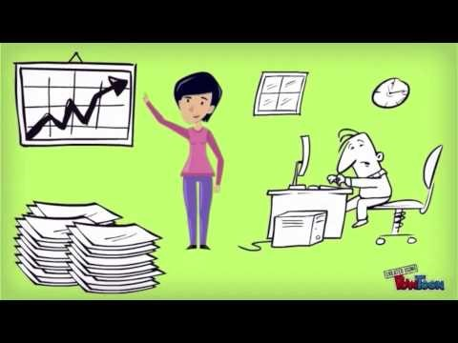
Video Activity:
Everyone is Smart, by Bradley Lands
What are three lessons Mr. Lands learned?
Do you agree or disagree with Mr. Lands when he states that “…challenges and weakness can be met with education, practice, and hard work”?
  Justify your answer
Any other thoughts?

Slide 6
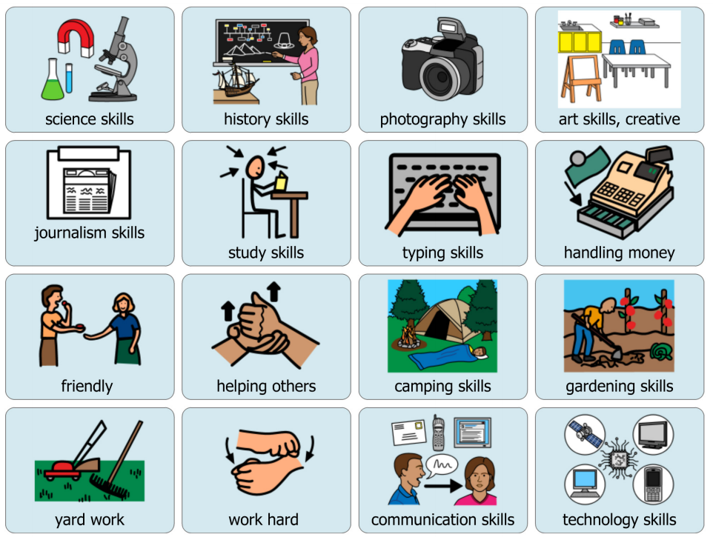
Application Activity:
Game Rules:
Divide into groups of up to 8 students.
Each groups receives one set of cards.
Appoint a group Dealer who shuffles the cards and deals one card to each student. Dealer places remaining stack of cards face down in the middle.
Each person takes a look at the card and decides if it is a strength or weakness of their personality.
  When it’s your turn, if the card means something, keep in face down in front of you. If it doesn’t mean anything, place it face down in the bottom of the pile and draw a new card from the top of the deck.
Continue in a circle until all cards are gone.
Students can only reject one card during each turn.
If a card is rejected by all students, it can be moved to the side at the end of the game.
When all of the cards are gone, take turns sharing your cards and why it is a strength or weakness.
Strength and Weakness Card Game

Slide 7
Application Activity:
Discussion Prompts:
Which of the weaknesses on the list should people try to strengthen? Why?
Which of the weaknesses could be minimized or avoided during a career search? Why?
Which weakness would not be good to have if you were a:
  Firefighter?
  Teacher?
  Business man or woman working in an office?
  Clerk or salesperson working in a store?
  Person working in the medical field?
  Scientist?
What is another strength and its opposite (weaknesses) to add to this list?
Identify at least two weaknesses from this list that is a struggle.
Word Wall Extension

Slide 8
Synthesis Activity:
1. Is this word a strength or weakness?
2. Is it always a strength or weakness?
3. Or does it depend on the situation?
Word Wall Extension Activity

Slide 9
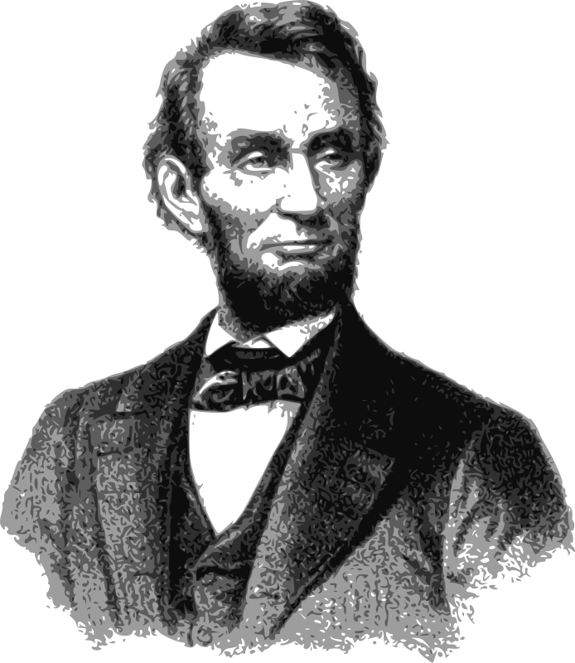
Cross Curriculum Activity:
Abraham Lincoln,
16th President of the United States
Honest Abe, Common Lit
Biography President Abraham Lincoln, by Ducksters Education Site
Video Biography of Abraham Lincoln: Meet the President for Kids (4:08 with CC)
Abraham Lincoln

Slide 10
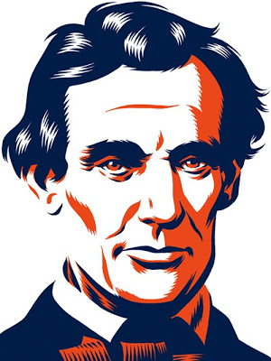
Cross Curriculum Activity:
Facts about Abraham Lincoln:
Grew up in Kentucky and was from a poor family.
Self-educated and became a lawyer.
Elected to the Illinois House of Representatives where he worked for 8 years before being elected president.
Nickname was “Honest Abe” and many people believe that President Lincoln was one of the most honest presidents.
16th president of the United States.
President during a difficult time for America during the Civil War. It was a time when the country was divided; the north and south had very different views (perspectives) on what they wanted and what was important to them.
Opposed to slavery and this did not make him popular with everyone.
Physical characteristics include his height of 6 feet 4 inches (the tallest president ever) and he had a full beard.
Abraham Lincoln

Slide 11
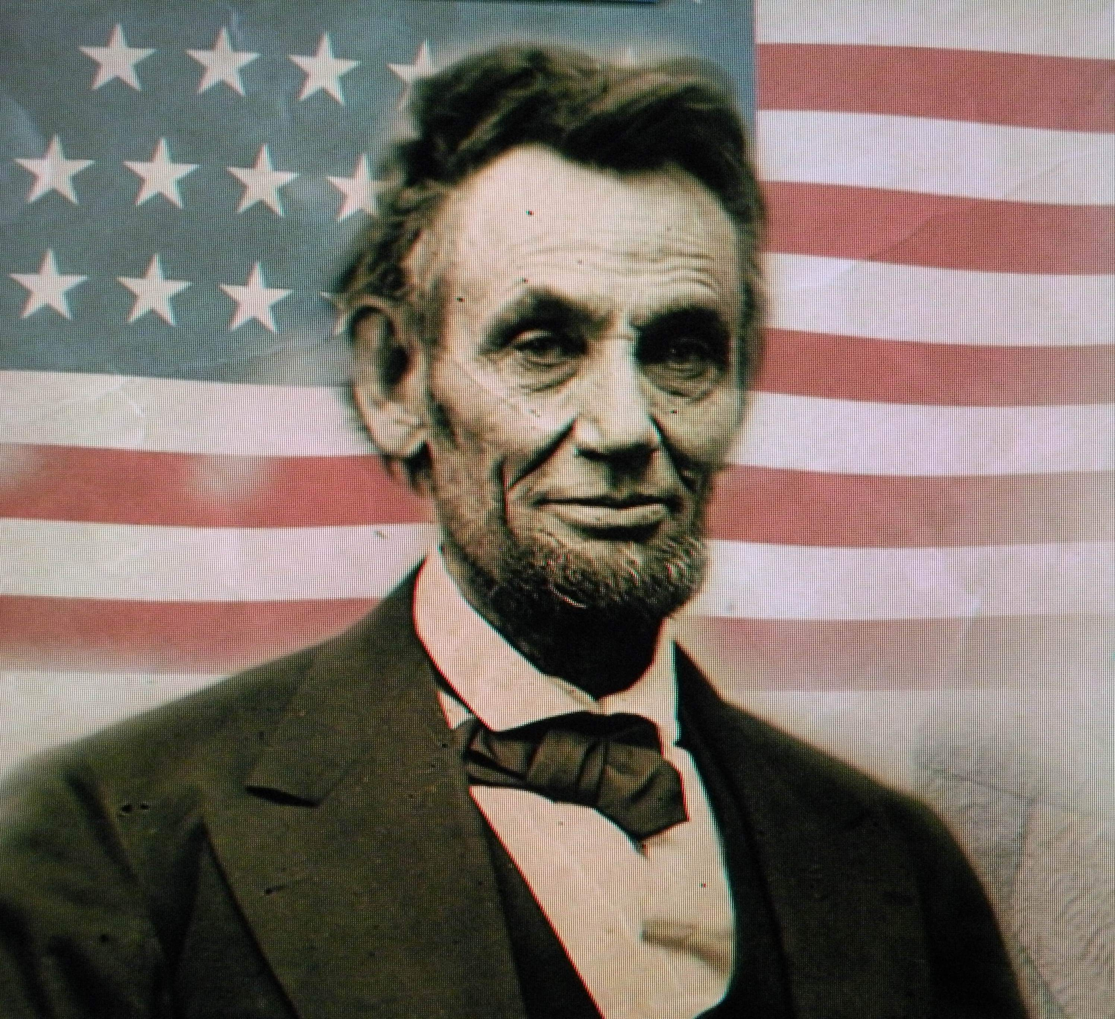
Cross Curriculum Activity:
President Lincoln was trustworthy and honest, and he assumed others always shared his values. However, this was not always true. Everyone has different values. Maybe he was too trusting, this weakness led to problems in his ability to lead his men.
Sometimes his orders were not followed and he gave his men many chances to change. It was not easy for Lincoln to discipline his men (punish them) or hold them accountable (make them do what they are supposed to do).
Some historians say that this weakness made the war last longer because he didn’t get rid of generals in his army that were doing a bad job.
What may have been some of Lincoln’s weaknesses?
Abraham Lincoln

